Slide 1
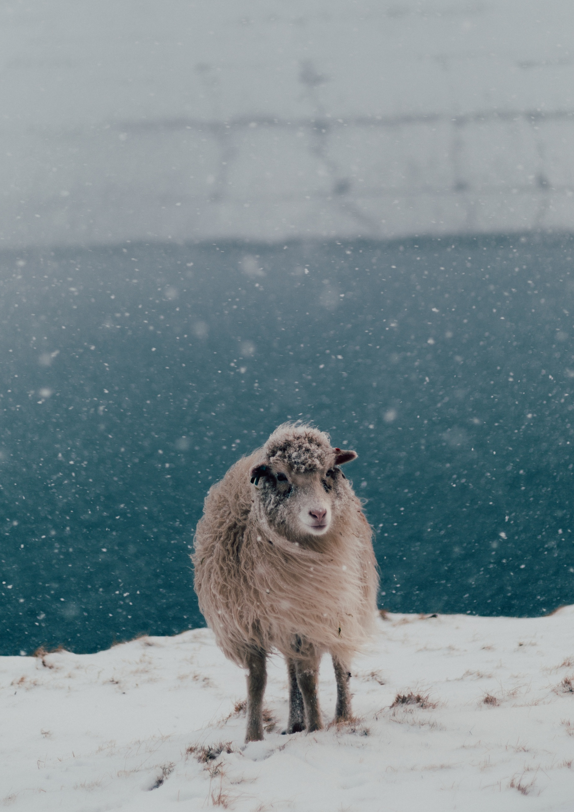
RIGHTS GUIDE
ILLUSTRATED BOOKS
Complete List

Slide 2
WELCOME!
In this Illustrated Rights Guide you’ll find our entire list of adult titles available for translation licenses. By clicking on the bookcovers of already published books, you can have a look inside.
Please get in touch, if you wish to receive more information or reading material for any of the titles in this list. I’m looking forward to hearing from you!
Best wishes,
Célia John, Rights Manager
rights@knesebeck-verlag.de
CONTENT
ILLUSTRATED BOOKS
3
LIFESTYLE
28
NARRATIVE NON-FICTION 52
CULINARY
68
CONTACTS
69
Knesebeck Verlag | Holzstrasse 26 | 80469 Muenchen | Germany | T +49 (0) 89 242 11 66-0 | rights@knesebeck-verlag.de | www.knesebeck-verlag.de

Slide 3
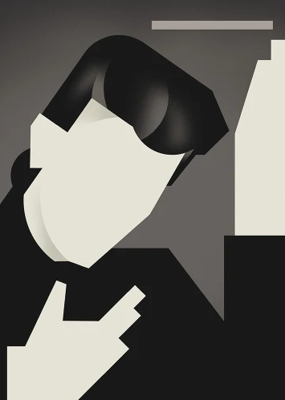
ILLUSTRATED BOOKS
© Dieter Braun

Slide 4

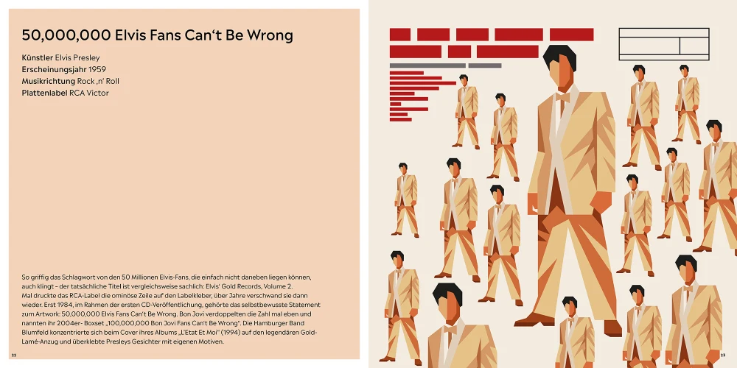
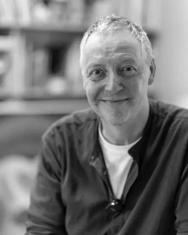
JUKEBOX HEROES
ICONIC ALBUM COVERS IN MINIMALIST DESIGN
Dieter Braun, Ingo Scheel
A Fresh Perspective on Legendary Covers
Album covers are more than just packaging - they shape how we discover, remember, and categorize music. This book presents iconic album artwork in minimalist illustrations, allowing their timeless visual power to be experienced anew.
Dieter Braun and Ingo Scheel combine design, music history, and personal perspectives in a tribute to cover art - as a statement, an identity, and a vessel of memory. Featuring influential albums from pop, rock, hip-hop, jazz, and electronic music - from David Bowie, The Beatles, and Pink Floyd to Björk, A Tribe Called Quest, and Daft Punk.
A visually striking collection with a high level of recognition: about music, design, and the collective memory of pop culture.
25.4 x 25.4 cm| hardcover | 176 pages | 86 illustrations| € 40.00 | ISBN 978-3-98962-141-1
Publication: October 2026
ILLUSTRATED BOOKS
WORLD RIGHTS AWAILABLE
Iconic album covers reimagined in Dieter Braun’s minimalist style
Music history & insider anecdotes by music journalist Ingo Scheel
A vinyl homage from Elvis to today: cover art for the eye, the ear, and the soul
The Illustrator
Dieter Braun works as a freelance illustrator and children's book author in Hamburg. He studied communication design at the Folkwangschule in Essen. His clients include Time Magazine, New York Times, Stern, Geo, DIE ZEIT, WWF to name but a few. His non-fiction books The World of the Mountains and The World of the Oceans were both priced as one of the most beautiful books of the year by the Stiftung Buchkunst (Book Art Foundation) and translated into 12 languages.
The Author
Ingo Scheel, born in Kiel in 1964, is a journalist, author, and musician. For decades, he has been writing for leading magazines such as Visions, MINT, Musikexpress, and Stern. His show, Flashback, airs on ByteFM. The Beatles, glam rock, and punk shaped his musical tastes; today, his vinyl collection also includes jazz, Thai pop, and soundtracks. With passion and wit, he tells the stories behind the album covers.

Slide 5
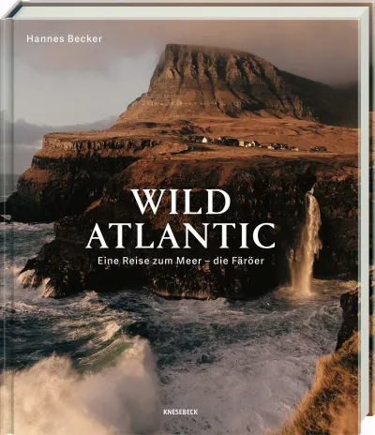
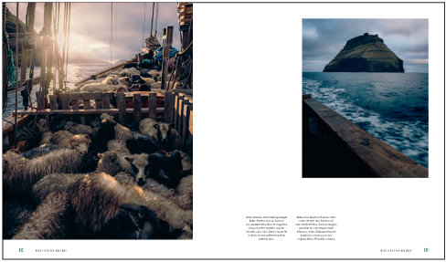
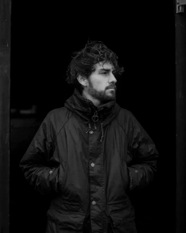
WILD ATLANTIC
A JOURNEY TO THE SEA – THE FAROE ISLANDS
Hannes Becker
The wild soul of the Faroe Islands in breathtaking images
A high-quality photo book capturing the fascination of Nordic ruggedness and life in the North Atlantic. Since his first journey in 2015, Hannes Becker has returned to the Faroe Islands time and again, developing a deep personal connection to this place over the years. Through striking photographs and short texts, he tells of storms, stillness, and light - of the relationship between people, land, and sea in the rhythm of the seasons. The images capture the wildness and raw beauty of the North, which continues to captivate so many - visually powerful, emotional, and timeless.
ILLUSTRATED BOOKS
24.0 x 28.0 cm| hardcover | 224 pages | 200 photographs | € 40.00 | ISBN 978-3-95728-407-5
Publication: October 2026
WORLD RIGHTS AWAILABLE
Untamed Faroe Islands: raw, wild, breathtakingly captured
Nature in its full force: rugged cliffs, atmospheric light, the wild Atlantic in all its power
First solo photo book by one of the most-followed top photographers (1.8 million followers on Instagram)
The Author
As a freelance photographer, Hannes Becker focuses on adventure and landscapes. Having grown up in a rural area, nature shaped his photographic style from an early age. He is a member of the renowned photography collective German Roamers. Through his images, he tells compelling stories of journeys around the world, placing great emphasis on composition and atmosphere.

Slide 6
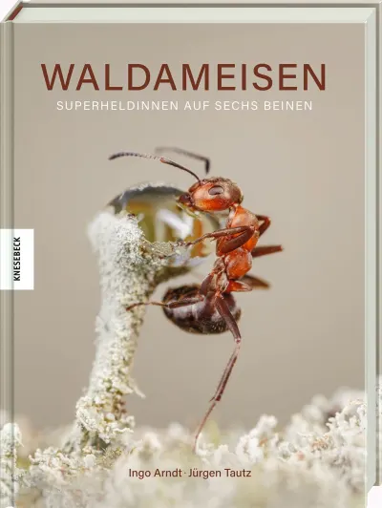

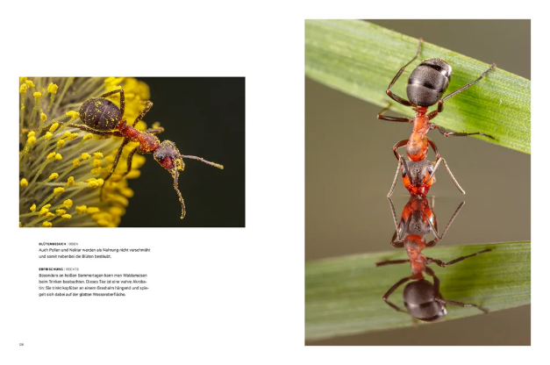
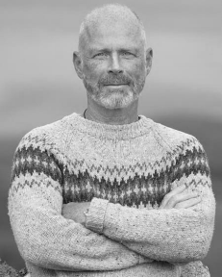
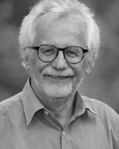
WOOD ANTS
SUPERHEROES WITH SIX LEGS
Ingo Arndt, Jürgen Tautz
A whole year of a wood ant colony
Wood ants are amazing. They are architects, indoor climate engineers, hunters, gardeners, livestock keepers, cleaners and real musclemen who even take on wild boars. Occasion- ally they even help birds with their plumage care. The tiny insects, which already existed on earth with the dinosaurs, are masters of division of labor and cooperation. Ingo Arndt and Jürgen Tautz have observed wood ants and their re- markable behavior throughout the year, many of which have been captured on camera for the first time. In unique images and descriptive texts, the two show how wood ants organize themselves and the important role they play in the forest ecosystem.
ILLUSTRATED BOOKS
21.5 x 28.5 cm | hardcover | 176 pages | 200 photographs | € 40.00 | ISBN 978-3-95728-840-0
Publication: March 2025
The multi-award-winning nature photographer Ingo Arndt shows sensational, never-before-seen images of the wood ant and its fascinating behaviors
SOLD TO: Korea
Including an award-winning picture from the Wildlife Photographer of the year 2024
Texts by ant expert Jürgen Tautz convey the latest findings in ant research in an entertaining and accessible way
›Great art, sometimes brutally realistic, just like life in nature.‹ – FRANKFURTER RUNDSCHAU
The Photographer
Ingo Arndt is one of the world's outstanding nature photographers. His pictures appear in international magazines such as National Geographic, GEO, Stern, or BBC Wildlife. He has received numerous awards, including a World Press Photo Award for his photos of free-living pumas in Patagonia. He has also won several prizes at the Wildlife Photographer of the Year Award.
The Author
Prof. Dr. Jürgen Tautz is a behavioral scientist, sociobiologist and insect expert. As professor emeritus at the Biocenter of the Julius-Maximilians-Universität Würzburg, he heads the interdisciplinary environmental research and education projects HOBOS (HOney-Bee Online Studies) and we4bee. He is also an internationally award-winning science communicator and bestselling author of successful popular science books on bees, some of which have been translated into over 20 languages.

Slide 7
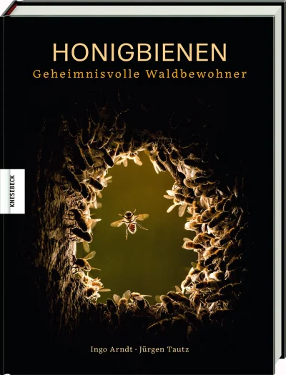
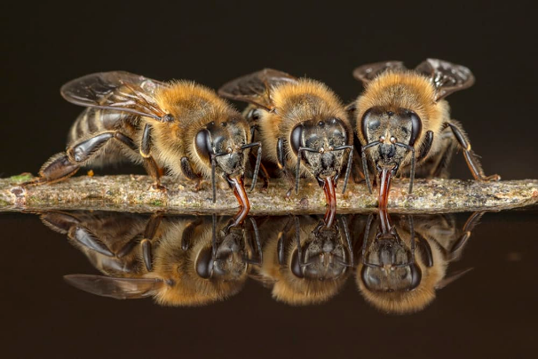
HONEYBEES
MYSTERIOUS FOREST DWELLERS
Ingo Arndt, Jürgen Tautz
Completely new insights into the mysterious life of wild honeybees
The bee is the new symbol of nature conservation, and people all over the world are studying its fate and the threat posed by mites, large-area agriculture and dwindling biodiversity. The honeybee is considered an endangered species, though the significance of its role as a pollinator can hardly be em- phasised enough. In contrast, the honeybee's close relative, the far more robust and adaptable wild bee, is little known. Prof. Dr. Tatz, the German authority on bees, is conducting major research into wild honeybees, while Ingo Arndt has captured sensational and unique photos documenting their life. This is a book full of exciting new insights which could revolutionise conventional apiculture and provide the im- petus for a move towards healthier, ecologically sound and appropriate beekeeping.
ILLUSTRATED BOOKS
21.5 x 28.5 cm | hardcover | 192 pages | 200 colour & b/w illustrations | € 38.00 | ISBN 978-3-95728-362-7
Publication: Spring 2020
20,000
copies
sold
SOLD TO: France, English worldwide, Czech Republic, Slovakia, Poland, Spain
The first book to present these brand-new photographic insights into the life of our honeybees in the forest
Shows many natural behaviour patterns of honeybees that have never before been documented in this way
›Ingo Arndt has gone in search of the ›wild‹ bees and his pic- tures, accompanied by the knowledgeable text of Prof. Dr. Jürgen Tautz, one of the most renowned bee researchers, provide fascinating insights into the life of these supposedly so well known animals.‹ – NATURFOTO
The Photographer
Ingo Arndt is one of the world's outstanding nature photographers. His pictures appear in international magazines such as National Geographic, GEO, Stern, or BBC Wildlife. He has received numerous awards, including a World Press Photo Award for his photos of free-living pumas in Patagonia. He has also won several prizes at the Wildlife Photographer of the Year Award.
The Author
Prof. Dr. Jürgen Tautz is a behavioral scientist, sociobiologist and insect expert. As professor emeritus at the Biocenter of the Julius-Maximilians-Universität Würzburg, he heads the interdisciplinary environmental research and education projects HOBOS (HOney-Bee Online Studies) and we4bee. He is also an internationally award-winning science communicator and bestselling author of successful popular science books on bees, some of which have been translated into over 20 languages.

Slide 8
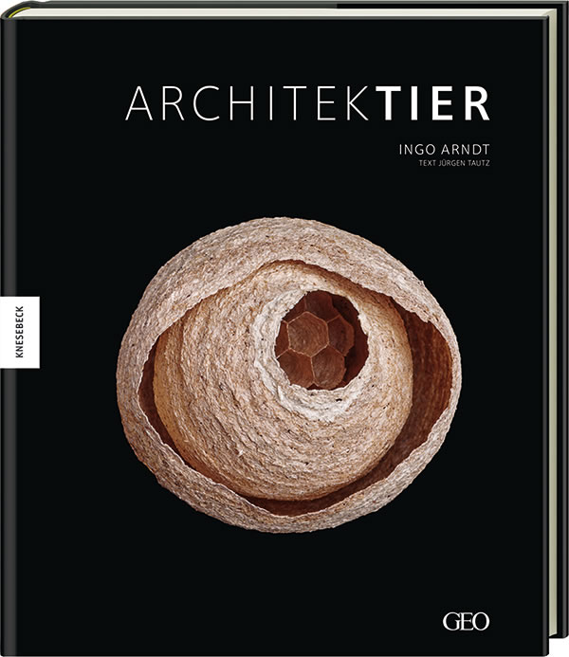
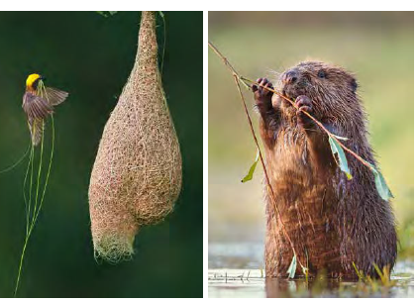
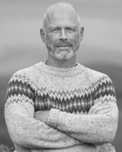
ANIMAL ARCHITECTURE
Ingo Arndt, Jürgen Tautz
The most brilliant builders in the world of animals
Over a period of two years, Ingo Arndt travels around the world in pursuit of his motifs. He takes pictures of the mounds, up to two meters tall, created by tiny wood ants in their indigenous woodlands as well as the colorfully decorated mating arenas of bowerbirds in West Papua; he presents enormous beaver dams in North America or previously unknown termite fields in Australia.
Besides their dwellings, the different animal species, the builders, are shown. The motifs from the wild are supplemented by a selection of studio photographs whose detailed views open up a world that otherwise remains hidden. Did you know, for example, that when spiders make their webs, they adhere to genetically determined blueprints? Or that compass termites align their mounds exactly with the position of the sun? The book holds these and many other surprises in store.
ILLUSTRATED BOOKS
27 x 31,7 cm | hardcover | 160 pages | 120 colour illustrations| € 49.95
ISBN 978-3-86873-568-0
Publication: October 2013
SOLD TO: English worldwide
Fascinating stories about animal architects, including their applied construction principles and tricks
Highly esthetical photographs
The Photographer
Ingo Arndt is one of the world's outstanding nature photographers. His pictures appear in international magazines such as National Geographic, GEO, Stern, or BBC Wildlife. He has received numerous awards, including a World Press Photo Award for his photos of free-living pumas in Patagonia. He has also won several prizes at the Wildlife Photographer of the Year Award.
The Author
Prof. Dr. Jürgen Tautz is a behavioral scientist, sociobiologist and insect expert. As professor emeritus at the Biocenter of the Julius-Maximilians-Universität Würzburg, he heads the interdisciplinary environmental research and education projects HOBOS (HOney-Bee Online Studies) and we4bee. He is also an internationally award-winning science communicator and bestselling author of successful popular science books on bees, some of which have been translated into over 20 languages.

Slide 9
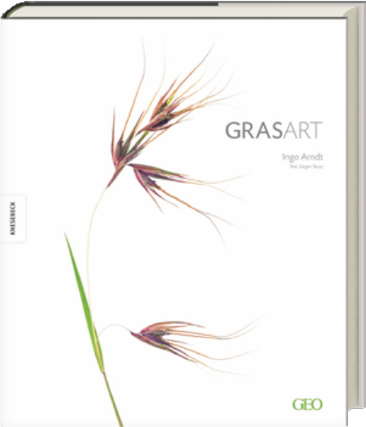
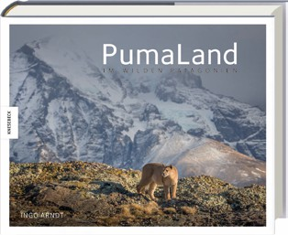
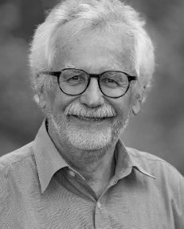
GRASS:ART
Ingo Arndt, Jürgen Tautz
On an underestimated species
Grass is a plant familiar to us all, yet the beauty of individual grasses and the seemingly endless grasslands to be found all over our planet go largely unnoticed. For more than two years, Ingo Arndt travelled the world, photographing tem- perate, tropical and wet grasslands and their inhabitants. His travels took him to the prairies and the Everglades of North America, the South American pampa, China's largest bamboo forest, the Mongolian steppes, the African savan-nah, the Tibet plateau and the world's largest reed-beds. His landscape pho- tos are supplemented by selected detail shots of the various types of grass. By reducing them to the quintessential, Ingo Arndt reveals the fundamental beauty of these seemingly inconspicuous plants.
27.0 x 31.7 cm | hardcover | 256 pages 200 colour illustrations | € 49.95
ISBN 978-3-86873-881-0
Publication: September 2016
SOLD TO: China
ILLUSTRATED BOOKS
PUMALAND
IN WILD PATAGONIA
Ingo Arndt
Wild land, wild cats
Over several years, his project Puma-Land, took Ingo Arndt to Torres del Paine national park to document the life of the cougars in stunning images. He made a total of seven visits to South America, spending six months photographing pumas. On his gruelling and adventurous expeditions, he captured unique shots of pumas, observing previously unseen hunting and mating rituals and witnessing hitherto unknown behaviours.
30.0 x 24.0 cm | hardcover with jacket
192 pages | 206 colour illustrations | € 45.00
ISBN 978-3-95728-204-0
Publication: February 2019
WORLD RIGHTS AVAILABLE
The Photographer
Ingo Arndt is one of the world's outstanding nature photographers. His pictures appear in international magazines such as National Geographic, GEO, Stern, or BBC Wildlife. He has received numerous awards, including a World Press Photo Award for his photos of free-living pumas in Patagonia. He has also won several prizes at the Wildlife Photographer of the Year Award.
The Author
Prof. Dr. Jürgen Tautz is a behavioral scientist, sociobiologist and insect expert. As professor emeritus at the Biocenter of the Julius-Maximilians-Universität Würzburg, he heads the interdisciplinary environmental research and education projects HOBOS (HOney-Bee Online Studies) and we4bee. He is also an internationally award-winning science communicator and bestselling author of successful popular science books on bees, some of which have been translated into over 20 languages.

Slide 10

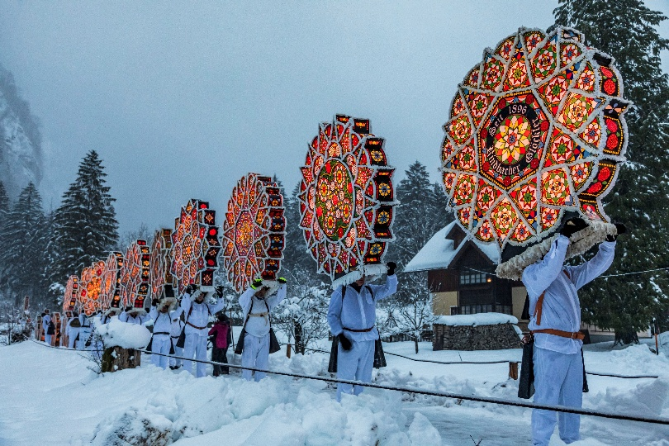
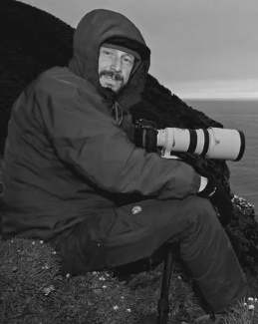
MASKED MAGIC AND DEMON DANCE
ALPINE RITES MYSTICISYM AND TRADITION
Bernd Römmelt
The new masterpiece by Germany's No.1 Alpine photographer
From December to carnival, the snow-covered Alps are transformed into a stage for centuries-old rituals - mysterious, archaic and full of symbolism. From the dark ‘Rauhnächte’ to wild carnival customs. Around 35 traditions from Germany, Austria, Switzerland, Italy and Slovenia show the deep-rooted belief in the powers of winter. In addition to well-known traditions, there are also secret rituals such as the Wild Hunt or the Bärbeletreiben. The impressive photo- graphs by Bernd Römmelt capture these traditions and show how the customs have changed. Accompanying texts explain the origins and background and allow us to participate directly in their fascination. A breathtaking insight into the wintry magic of the Alps.
ILLUSTRATED BOOKS
24 x 28 cm | hardcover | 240 pages |
180 photographies | € 40.00 |
ISBN 978-3-98962-024-7
Publication: October 2025
WORLD RIGHTS AVAILABLE
Bernd Römmelt captures the mystical atmosphere of Alpine customs like no other
From St Nicholas customs to Rauhächte and carnival celebrations: rites from the entire Alpen region
Traditional practices are experiencing a powerful revival
Supplemented by concise information on each custom
The Photographer
Bernd Römmelt, born in 1968, is a native of Munich and has been working as a freelance photographer and travel journalist since 2001. He particularly en- joys travelling to the far north or the Alps for his work. During his travels, he has taken many pictures that have already been honoured with the most im- portant and prestigious nature photography competi- tion in the world, the Wildlife Photographer of the Year Award.

Slide 11
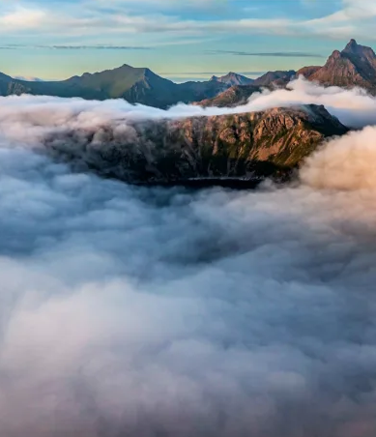
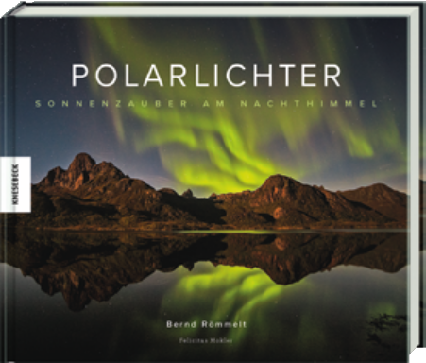

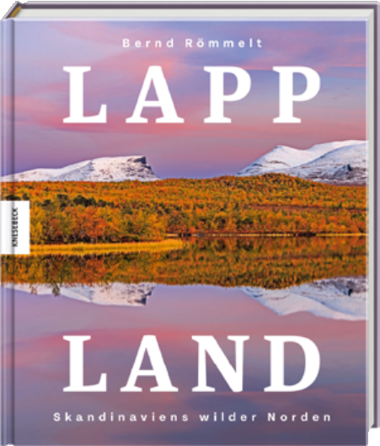
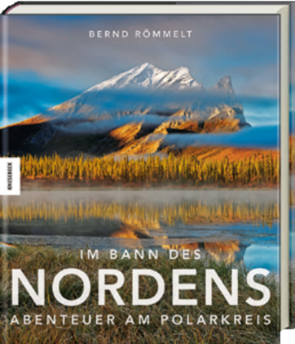
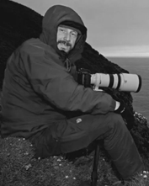
NOTHERN LIGHTS
SOLAR SPLENDOUR IN THE NIGHT SKY
Bernd Römmelt, Felicitas Mokler
24,000
copies
sold
A magical journey to the land of the Northern Lights
In the far north of Europe, above the Arctic Circle, lies a very special region: Lapland. The area, which stretches from the north-west of Norway to the far north-western tip of Russia, is still largely untouched and wild with its dense forests, rugged highlands and mountainous coastline. In this illustrated book, nature photographer Bernd Römmelt portrays the fascinating beauty of this region. In impressive photographs, he captures the wild nature of Lapland during all seasons, the unique play of colors and light of the midnight sun and the Northern Lights and visits the Sámi, who are deeply rooted in the region.
An impressive illustrated book for nature lovers and a unique photographic portrait of the wild north of Scandinavia.
26.0 x 22.0 cm | hardcover | 128 pages 150 colour illustrations | € 28.00 |
ISBN 978-3-95728-787-8
Publication: August 2023
WORLD RIGHTS AVAILABLE
ILLUSTRATED BOOKS
LAPLAND
24.0 x 28.0 cm | hardcover | 192 pages | 180 colour illustrations | € 40.00 |
ISBN 978-3-95728-874-5
Publication: October 2024
BEGUILED BY THE NORTH
27.0 x 31.7 cm | hardcover with jacket |
320 pages | 240 colour illustrations | € 49.95 |
ISBN 978-3-86873-988-6
Publication: September 2017
WORLD RIGHTS AVAILABLE
WORLD RIGHTS AVAILABLE
The Author and Photographer
Bernd Römmelt was born in Munich in 1968. He has been working as a freelance photographer and travel journalist since 2001. His work focuses on the Alps and the far north. The well-known author has already published over thirty illustrated books. Some of his pictures have won awards at the most important and prestigious nature photography competition in the world, the Wildlife Photographer of the Year.

Slide 12
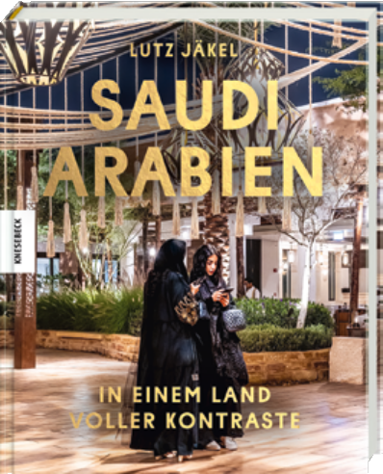
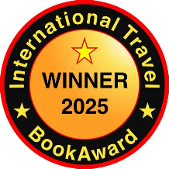
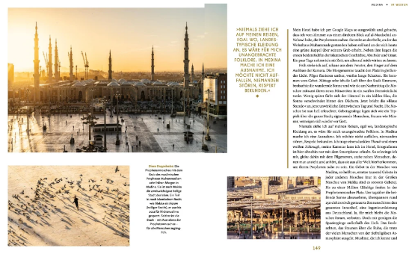
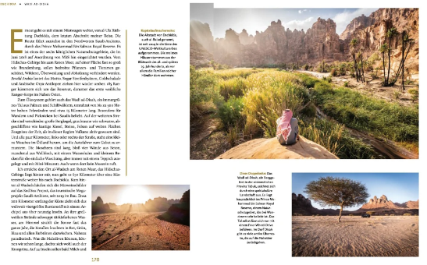
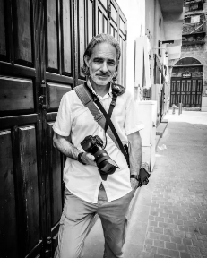
SAUDI ARABIA
IN A COUNTRY OF CONTRASTS
Lutz Jäkel
Saudi Arabia up close
Saudi Arabia was virtually sealed off until 2019, when it opened its doors to tourism. Lutz Jäkel has traveled through this contradictory country by car, train and bus. In unique pictures and informative and personal texts, he takes us on an extraordinary journey. We meet the kingdom's first fe- male DJ, listen to the muezzin in Medina and cruise through Khobar with Harley riders. We travel from the capital Riyadh through the desert, along the coast and through spectacular mountain regions. Based on his many encounters, Lutz Jäkel brings us closer to a country caught between tradition and transformation and does not leave out critical issues such as the women's and human rights situation.
ILLUSTRATED BOOKS
20.5 x 25.5 cm | hardcover | approx. 192 pages | 150 photographs | € 35.00
ISBN 978-3-95728-897-4
Publication: April 2025
WORLD RIGHTS AVAILABLE
Insights into a largely unknown, beautiful country that is slowly opening up to tourism
A region between Islamic tradition and dazzling modernity, brilliantly captured by photographer and Islam expert Lutz Jäkel
With many views into the everyday life of the people
›Saudi Arabia: A Land of Contrasts’ is more than just a travelogue with beautiful photos. It is a book about humanity and the courage to discover the unknown – even when you think you have seen it all.‹ – NDR Kultur
The Author and Photographer
Lutz Jäkel is a photojournalist, author and lecturer. He grew up in Istanbul, studied Islamic Studies in Hamburg and lived for a time in Syria and Yemen. He has been traveling and photographing the world and writing about it for many years. His photos and reports appear in Stern, SPIEGEL and GEO, among others. His work has received numerous awards. Lutz Jäkel lives in Berlin.

Slide 13
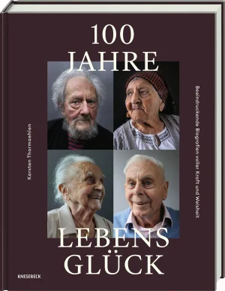
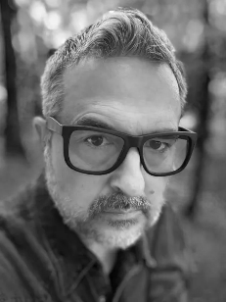
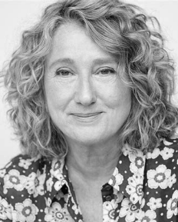
100 YEARS OF HAPPYNESS
BIOGRAPHIES OF STRENGTH AND WISDOM
Karsten Thormaehlen, Constanze Kleis
How does it feel to live for a century?
In his new illustrated book, internationally renowned photographer Karsten Thormaehlen presents 50 fascinating portraits of centenarians from around the world. With sensitive photographs and moving life stories, he shows the wisdom, strength and beauty of old age. 100 Years of Happiness is an impressive tribute to long life and a plea for ageing with dignity. The photo reportage is not a guide to longevity, but an invitation to listen, marvel and empathise. An inspiring collection that provokes thought and invites us to take a fresh look at ageing.
ILLUSTRATED BOOKS
21.5 x 27.8 cm | hardcover | 144 pages |
75 photographies | € 30.00 |
ISBN 978-3-95728-990-2
Publication: August 2025
Karsten Thormaehlen captures the dignity of 100-year-olds in impressive portraits
WORLD RIGHTS AVAILABLE
How do you become 100+? Their biographies and quotes are signposts for a fulfilled life without optimisation mania
A topic of growing importance as we all get older
The Photographer
Karsten Thormaehlen, photographer, studied communication design and lived in New York. He is passionate about photography, editing and curating. His award-winning portraits of senior citizens around the world challenge our often negative image of old age. His work has been exhibited internationally, published in numerous illustrated books and inspired the WHO to launch a campaign against ageism.
The Author
Constanze Kleis is a German bestselling author and journalist. She writes about relationships, ageing and social issues. She became known for her books with Susanne Fröhlich and her collaboration with photographer Karsten Thormaehlen on ageing is sues. Her book Sterben Sie bloß nicht im Sommer (Just Don’t Die in Summer) deals with the end of life with humour and depth. She lives and works in Frankfurt am Main.

Slide 14
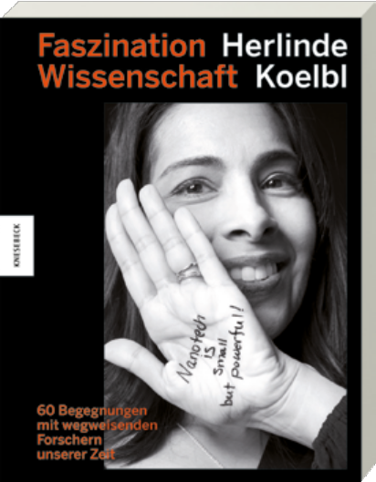

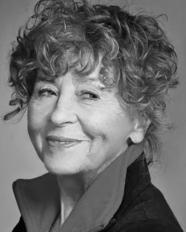
THE FASCINATION OF RESEARCH
60 ENCOUNTERS WITH PIONEERING RESEARCHERS OF OUR TIME
Herlinde Koelbl
›At the end of a successful day, you might have changed the world because you discovered new knowlegde and made it accessable to mankind ...‹ – David Avnir
For her latest project, well-known photographer Herlinde Koelbl visited top scientists worldwide, who outlined their areas of research and related their experiences. Each re- searcher sketched the basics of his or her work on the palm of their hand, making science tangible in the truest sense of the word! A photographic project which conveys the fas- cination of science in an unusually accessible way and of- fers a unique insight into the world of science, where men and women, independent of their origin and nationality, are driven by the same motivations: curiosity and the thirst for knowledge.
ILLUSTRATED BOOKS
21.5 x 27.8 cm | hardcover | 352 pages | 120 b/w illustrations | € 35.00
ISBN 978-3-95728-426-6
Publication: October 2020
SOLD TO: English worldwide, China, Korea
BORIS PISTORIUS - DEPARTURE
CONVERSATION WITH HERLINDE KOELBL
Herline Koelbl
Who is Boris Pistorius?
Boris Pistorius has been Germany's most popular politician since the beginning of his term as Defence Minister. With concrete plans, he is shaping the Bundeswehr into a defence-oriented army and reshaping Germany's image both nationally and internationally. But who is the person behind? Photographer Herlinde Koelbl shows Pistorius from a new perspective: objective, direct and visionary. In eight interviews held in 2024, she talks to him about his roots, his career, his goals and the challenges of his time in office.
16.0 x 23.2 cm | softcover with flaps | 152 pages | 53 photographs | € 24.00
ISBN 978-3-98962-013-1
Publication: February 2025
WORLD RIGHTS AVAILABLE
The Author and Photographer
Herlinde Koelbl is one of the most renowned German photo artists. Her extensive work is characterised above all by long-term photographic projects, often complemented by in-depth conversations. Her photographs have been shown in numerous international exhibitions and are represented in many important collections. She has published over a dozen photo books, including The German Living Room, Strong Women, Jewish Portraits, Hair and Targets. She has received numerous awards, including the Order of Merit of the Federal Republic of Germany in 2009.

Slide 15
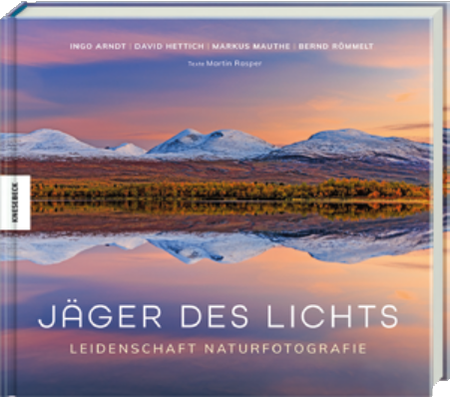
HUNTERS OF THE LIGHT
PASSION NATURE PHOTOGRAPHY
Ingo Arndt, David Hettich, Markus Mauthe, Bernd Römmelt, Martin Rasper
Top nature photography – four photographers, one passion
The eerie beauty of a squid at night, African landscapes shaped like paintings from a bird's eye view, a wild cougar mother watching over her frolicking cubs or icy landscapes on Greenland bathed in the most beautiful shades of red and orange: four exceptional photographers open their archives and show us things and places that most of us would prob- ably never get to see otherwise. They tell us about their ad- ventures, their motivation and their very personal working methods and approaches. A must-have for all nature-pho- tography fans!
28.0 x 24.5 cm | hardcover | 176 pages 220 colour illustrations | € 40.00 |
ISBN 978-3-95728-713-7
Publication: April 2023
WORLD RIGHTS AVAILABLE
ILLUSTRATED BOOKS
Passion for the perfect picture: Four successful exceptional photographers provide insight into the process of creating their photographs and the working world of today's nature photographers
›If it is already great to read what the four absolutely exceptional photographers have to report, their photographs are overwhelmingly impressive.‹ – LEBENSART
They photograph animals all over the world, dive into the silence of the oceans, make nature conservation with their cameras and search for the perfect mountain light – an
ex-traordinary illustrated book with a wide range of sub- jects
The Photographers
Ingo Arndt is one of the world's outstanding nature photographers. His pictures appear in international magazines and journals.
Bernd Römmelt is an award-winning photographer and travel journalist. His work focuses on the Alps and the far north.
Markus Mauthe is a photographer and environ-mental activist. In books and live reports he shows the beauty of the world and draws attention to its threats.
David Hettich's logbook keeps track of over 2500 dives around the world. His underwater photo- graphs appear in advertising campaigns, calendars and magazines.
The Author
Martin Rasper has been writing about nature and science for thirty years; he was editor at natur and most recently editor-in-chief of bienen&natur. He has known the photographers and their work for many years.

Slide 16
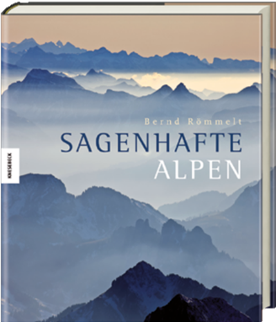

LEGENDARY ALPS
Bernd Römmelt
Sublime landscapes and folklore traditions
Bernd Römmelt captures the magic of the mountains, show- ing the Alps and their ancient, living cultures as they have never been portrayed before. People wearing archaic masks and wild costumes, the landscape of the Alps through the changing seasons, by day and by night, when an unbeliev- able calm descends over the mountains – spectacoulus images never seen before. Some of the images were taken during violent thunderstorms, crystal-clear mountain lakes, flower-strewn meadows, rugged gorges and raging water- falls. However, the book also draws attention to the threat represented by tourism and the overexploitation of the Alps. These fascinating pictures bear witness to the beauty of the mountains and illustrate why so many people are drawn to this magnificent natural and cultural landscape!
27.0 x 31.7 cm | hardcover with jacket |
224 pages | 230 colour illustrations | € 39.95
ISBN 978-3-86873-658-8
Publication: September 2014
ILLUSTRATED BOOKS
WORLD RIGHTS AVAILABLE
THE ZUGSPITZLAND
Bernd Römmelt
A unique photographic portrait of the Zugspitze region
It is a landscape of contrasts: Behind the Blue Land with the largest moorland in Central Europe, the Wetterstein rises to a height of almost three kilometres. This unique combi- nation of mountain, moor, forest and wild river landscapes, overlooked by Germany's highest mountain, is portrayed by nature photographer Bernd Römmelt, an intimate connois- seur of the region for decades. In impressive photographs he captures the beauty of this unmistakable region – and intro- duces us to very special inhabitants who give it its character.
26.0 x 22.0 cm | hardcover | 192 pages | 180 colour illustrations | € 38.00 | ISBN 978-3-95728-736-6
Publication: August 2023
WORLD RIGHTS AVAILABLE
The Author and Photographer
Bernd Römmelt was born in Munich in 1968. He has been working as a freelance photographer and travel journalist since 2001. His work focuses on the Alps and the far north. The well-known author has already published over thirty illustrated books. Some of his pictures have won awards at the most important and prestigious nature photography competition in the world, the Wildlife Photographer of the Year.

Slide 17
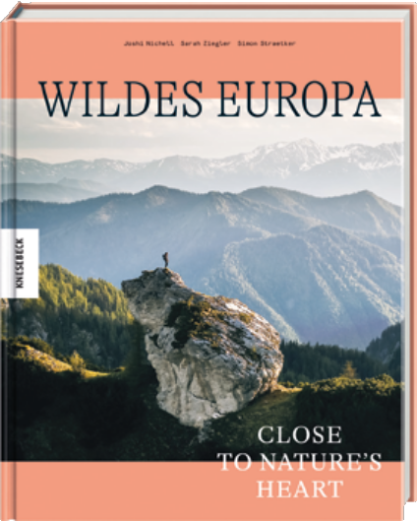
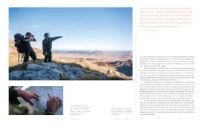
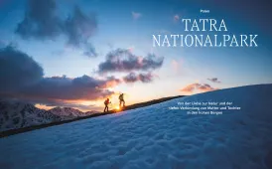
WILD EUROPE
CLOSE TO NATURE'S HEART
Simon Straetker, Joshi Nichell, Sarah Ziegler
Discover the unspoiled nature of Europe
Discover the most remote areas of Europe and experience the beauty and fragility of nature. Impressive photos take us to six breathtaking natural landscapes such as the Span- ish Somiedo Nature Park, the Egadi Islands or the primeval forests of the Carpathian Mountains. We accompany people who are committed to preserve nature and discover their in- spiring stories about the protection of the treasures that lie right on our doorstep.
ILLUSTRATED BOOKS
20.5 x 25.5 cm | hardcover | 200 pages | 130 colour illustrations | € 35.00 |
ISBN 978-3-95728-817-2
Publication: January 2024
WORLD RIGHTS AVAILABLE
On a road trip: Three representatives of the new generation of nature photographers explore the wild and untouched soul of Europe in regions and national parks from Spain to Romania
Nature Photography: Impressive images of Europe's wild areas as well as emotional portraits of the people who want to preserve them, convey the importance of these areas for all of us
Including spectacular views of areas in Montenegro, Roma- nia, Austria, Italy, Poland and Spain
›The 200-page illustrated book is an impressive plea for the protection and preservation of European wilderness – a mat- ter close to the hearts of those who have spent months ex- ploring the wild corners of Europe.‹ – STUTTGARTER ZEITUNG
The Authors and Photographers
Simon Straetker is a passionate filmmaker, globetrotter, and environmental ambassador. He has been awarded the German Nature Conservation Prize, among others, and was one of Forbes Magazine's 30 Under 30 (Europe) in the arts category.
Joshi Nichell is a conservation biologist known for his unique wildlife photography. He hitchhiked to Tierra del Fuego and wrote about it in his book Full Happiness Ahead.
Sarah Ziegler is a filmmaker and diver who is involved in conservation and civilian sea rescue. Together, the three founded the association Wild Europe.

Slide 18
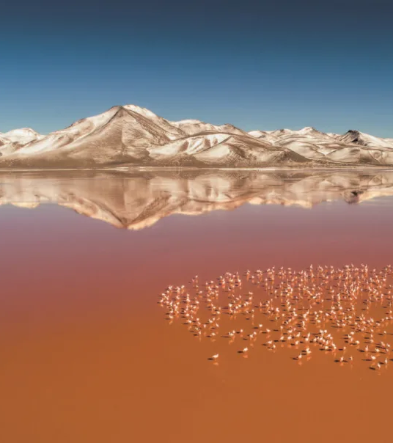


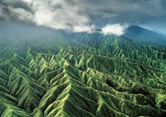
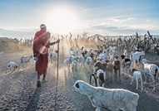
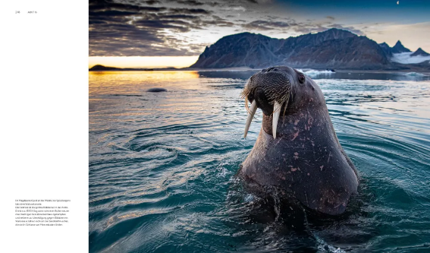
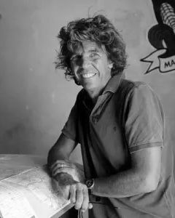
TERRA
FACES OF EARTH
Michael Martin
12,000
copies
sold
Nature photography in a class of its own
Today, 4.5 billion years after its birth, our planet is in its prime. Unfortunately, however, man has interfered so mas- sively in system Earth that it can no longer be termed a par- adise. In this book, Michael Martin describes in profound, informative texts the fascinating history of our planet and the influence of man on nature. In breathtaking images, the author portrays the beauty and diversity of Earth and shows just how much we stand to lose if we do not succeed in pro- tecting our planet better.
ILLUSTRATED BOOKS
29.0 x 35.0 cm | hardcover with jacket | 448 pages 500 colour illustrations | € 75.00
ISBN 978-3-95728-337-5
Publication: September 2022
SOLD TO: China
The incredible history of Earth, told in words and images – what makes our planet so special, the forces which shape and mould it and how it came to be as we know it today
The Earth in its fascinating uniqueness and fragility
An ambassador for our Earth: Michael Martin has probably observed and documented our planet and its changes more intensively than any other nature photographer
The Author and Photographer
Michael Martin, born in Munich in 1963, is a photographer and qualified geographer. For more than 40 years, he has reported on his journeys to the deserts of the Earth and is now the world's best-known desert photographer. He has published 30 photo volumes and books which have been translated into seven languages, has delivered almost 2000 lectures and produced several TV films. His work has won numerous awards, for example an honorary award from the Royal Geographic Society. He recently received the Gregor International Calendar Award and the ITB Book Award for his life's work.

Slide 19
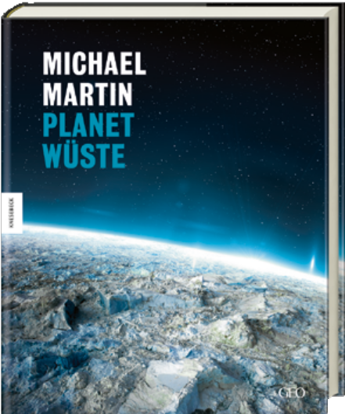
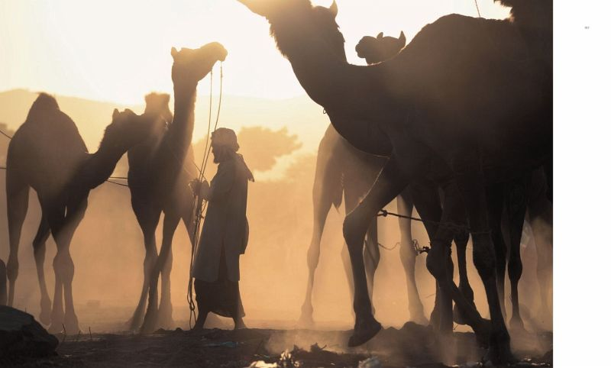
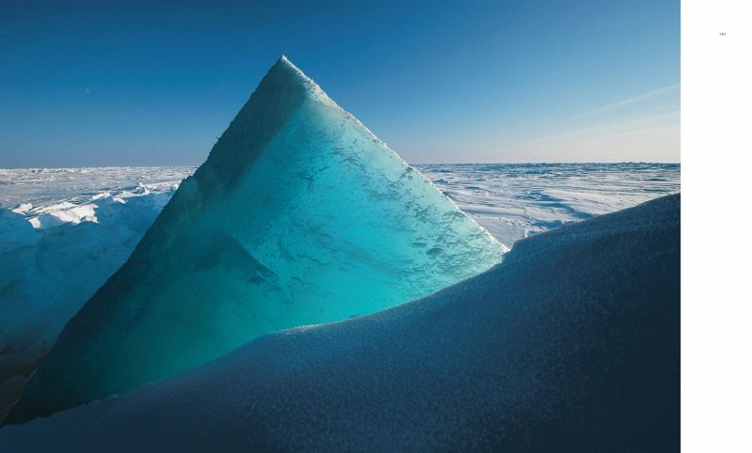
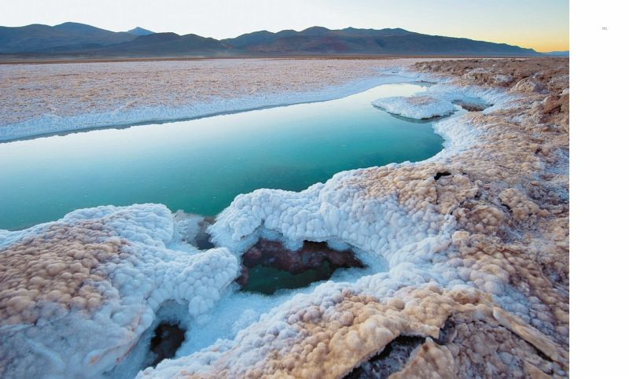
PLANET DESERT
Michael Martin
20,000
copies
sold
A titanic masterwork
After the worldwide success of Deserts of the Earth, this book provides a surprising and never shown confrontation of the ice desert and the sandy deserts. Martin, one of the world's experts on these extreme living spaces, portrays in his emo- tive pictures and expert texts each desert in its uniqueness and beauty.
Never before have these both deserts been confronted so impressively in word and picture. What Michael Martin, ad- venturer, photographer and geographer has undertaken here is no less than an extraordinarily ambitious attempt to document the whole variety of these completely different deserts. The unique pictures and science-based text come together to create a standard work.
ILLUSTRATED BOOKS
29.0 x 35.0 cm | hardcover with jacket | 448 pages | 400 colour illustrations | € 49.95 |
ISBN 978-3-86873-709-7
Publication: September 2015
SOLD TO: English worldwide, France, China
Awarded Knowledge Book of the Year 2016 by the magazine bild der wissenschaft
Breathtaking photographies of hardly known places
›Michael Martin's photos of faces full of experience cap- tivate the viewer just as much as the grandiose landscape shots.‹ – DONAUKURIER
The Author and Photographer
Michael Martin, born in Munich in 1963, is a photographer and qualified geographer. For more than 40 years, he has reported on his journeys to the deserts of the Earth and is now the world's best-known desert photographer. He has published 30 photo volumes and books which have been translated into seven languages, has delivered almost 2000 lectures and produced several TV films. His work has won numerous awards, for example an honorary award from the Royal Geographic Society. He recently received the Gregor International Calendar Award and the ITB Book Award for his life's work.

Slide 20



VOLCANO PEOPLE
LIVING WITH THE FORCES OF NATURE
Ulla Lohmann
The fascinating primeval energy of our planet
On the Italian island of Vulcano, the Canary Islands or one of the over 150 fire-breathing mountains in Indonesia: the world over, people live near, on and in particular with volca- noes. For example, because they profit from the fertile land – and nevertheless, they live with death on their doorstep. Renowned and award-winning photographer Ulla Lohmann visits seven regions worldwide in search of Earth's primeval energy. In impressive images and exciting texts, she shows how a chicken gives warning of an impending eruption and what we can learn from a life with the forces of nature.
ILLUSTRATED BOOKS
20.5 x 25.5 cm | hardcover | 192 pages | 200 colour illustrations | € 38.00 |
ISBN 978-3-95728-699-4
Publication: April 2023
WORLD RIGHTS AVAILABLE
Spectacular photos accompany perceptive and up-close insights into the life of people who live on or near active volcanoes
Impressive accounts of people and animals who have learned to live with volcanoes and benefit from them
Polyglot volcano expert Ulla Lohmann is one of Germany's leading and best-known nature photographers
›This illustrated book portrays not only the fiery and beauti- ful spectacle of the volcanoes, but above all the people who live in harmony with the forces of nature.‹ – ALPIN
The Author and Photographer
Ulla Lohmann, born in 1977, is a photographer and filmmaker whose work focuses on active volcanoes. She finds it particularly intriguing how people live with ›their‹ fire-breathing mountains and how wild and untamed nature is – even in Europe. Together with her husband and expedition partner Basti Hof- mann, she holds the record for the deepest rope descent into an active volcano. Her son Manuk is named after the Indonesian volcano.

Slide 21





HEAVEN AND HELL
THE BEAUTY OF EXTREME NATURAL PHENOMENA
Dennis Oswald, Adrian Rohnfelder
Extreme weather in all its majestic beauty
The deafening roar of tornadoes, the primeval roar of fire, the crack of lighting, icy winds, literally deadly desert re- gions – Dennis Oswald and Adrian Rohnfelder are drawn to locations where nature shows itself from its most extreme side. In this book, they take us with them on an adventurous journey to places on this earth which not many people ex- perience – and live to tell the tale. Their fascinating photos show the demonic force, but also the heavenly beauty of our planet. A book that will take your breath away.
ILLUSTRATED BOOKS
20.5 x 25.5 cm | hardcover | 160 pages | 190 colour illustrations | € 36.00 | ISBN 978-3-95728-714-4
Publication: March 2023
WORLD RIGHTS AVAILABLE
Whirling tornadoes, bolts of lightning, towering cloud for- mations or bubbling volcanoes: unique photographs show the awe-inspiring beauty of the forces of nature in our era
›Tornado Alley‹ in the USA, the ›Gates of Hell‹ in Turkmen- istan, ›Point of No Return‹ in Ethiopia: a daring voyage around the world to places hardly ever seen
Fascinating pictures which will amaze readers and invite them to linger – with brief background information on the natural phenomena shown
›These shots create a sometimes sombre, sometimes peaceful mood that is difficult to escape from.‹ – FRANKFURTER ALL- GEMEINE ZEITUNG
The Authors and Photographers
Dennis Oswald studied Geography and Meteorology and is a keen photographer. For 25 years, he has spent every free minute chasing photogenic thunderstorms, for preference in the American Midwest. Oswald's second great passion is the endless ex- panse of the American deserts. His award-winning images are published in calendars, articles, books and lectures.
Some years ago, photographer Adrian Rohnfelder exchanged his well-paid job as a consultant and his suit for a life of adventure, following his passion with a camera. Since then, he has travelled the most extreme places on our planet in search of the forces of nature in action. He reports on his experiences in articles and books, delivers lectures to large audi- ences and has won numerous international awards.

Slide 22



THE WILD HEART OF
EUROPE
THE RETURN OF LYNX, WOLF AND BEAR
Marc Graf, Christine Sonvilla
Central Europe is wild again!
Wolf, brown bear and lynx in unspoiled forests – but hardly
anyone would expect to find those forests in densely populated Central Europe. Yet despite its bustling urban conurbations, tourism and industry, the heart of Europe has managed to retain areas of unspoiled wilderness, and, with human assistance, these animals, once almost extinct in the wild, are now beginning to return to the Alps. A major challenge for modern-day Europe in the 21st century. Sheep breeders fear for the safety of their stock, hunters face competition, and there are concerns about the personal safety of those seeking relaxation in nature: is there still a place for wild animals in Central Europe?
In this book nature photographers Christine Sonvilla and Marc Graf document the return of these predatoris to the heart of Europe. Together with shepherds, foresters and scientists, they examine the question of just how wild we can allow Europe to be.
ILLUSTRATED BOOKS
20.5 x 25.5 cm | hardcover | 200 pages | 130 colour illustrations | € 35.00 |
ISBN 978-3-95728-817-2
Publication: January 2024
WORLD RIGHTS AVAILABLE
The return of lynx, bear and wolf to the forests on our doorsteps
Previously unpublished, creative and fresh photos from young photographers show the three largest European predators in their natural habitat
The widely debated and controversial subject of the reintroduction of predators to areas used by man
›The Wild Heart of Europe is more than a photographic reportage, the well-founded texts and breathtaking pictures show the current and explosive topic of nature conservation and economic interests.‹ – WIENER JOURNAL
The Author and Photographer
Christine Sonvilla and Marc Graf are professional photographers, film-makers and authors. In their work, the trained biologists aim to promote biodiversity and the protection of our ecosystems and boost public perception of environmental topics. Their photos have been published in many print magazines, including National Geographic Deutschland, and have featured in exhibitions and live presentations. The two also work on TV film productions for ORF, arte, ZDF, or Servus TV. Christine Sonvilla and Marc Graf live in Mürzzuschlag in Styria/Austria.

Slide 23


EUROPE'S HOLY MOUNTAINS
HIGH AND HOLY
PLACES OF LONGING, SOURCES OF FASCINATION
Nina Ruhland, Bernd Ritschel
PILGRIMAGE IN THE ALPS
S. Rosenboom, S. Freudenberg
ILLUSTRATED BOOKS
Off to the Alps!
The special power of sacred mountains
In the Alpine region, there are numerous mysterious paths, sacred pilgrimage destinations and places of pagan origin: hermitages on remote mountain meadows, monasteries and chapels, legendary springs ... Sandra Freudenberg and Ste- fan Rosenboom walk 12 of these special paths in Germany, Austria, Italy and Switzerland. The selection ranges from a few hours walking time to pilgrimages almost two weeks long – for all seasons. They delve deep into the respective cultures and shed light on people, history, backgrounds – and some- times even miracles.
Shrouded in myth, threatening and at the same time seen as a blessing, sacred mountains have woven their spell over us for centuries. Wherein lies their fascination? Bernd Ritschel and Nina Ruhland explore this question in their illustrated book. They portray large and small mountains, famous peaks, but also lesser-known destinations, they look into these places of power and people's connection with them. And they show that the world seen from above opens up the view in every respect.
24.0 x 28.0 cm | hardcover | 208 pages | 160 colour illustrations | € 40.00 | ISBN 978-3-95728-871-4
Publication: September 2024
20.5 x 25.5 cm | hardcover | 208 pages | 120 colour illustrations | € 38.00 | ISBN 978-3-95728-637-6
Publication: March 2024
WORLD RIGHTS AVAILABLE
WORLD RIGHTS AVAILABLE
The Author and the Photographer
The Author and the Photographer
Bernd Ritschel lives with his family in Kochel am See in close proximity to mountains. For over 35 years, taking photographs of mountains has been a deeply rooted passion for him. He has published more than 35 illustrated books, written numerous textbooks and designed over 100 calendars. His impressive photographs have been published in prestigious magazines such as Geo and National Geographic.
Stefan Rosenboom is a freelance photographer working for the Leica Academy and others and is known for his award-winning multivision lectures. He has the rare ability to tell stories with his images that touch the beholder deeply and will stay with them for a long time.
Sandra Freudenberg grew up in the Eifel, later moved to the Alps and became an enthusiastic mountaineer. After successful years as managing director of a PR agency, she now writes books and articles on nature and mountain topics and is co-founder of the Alpen Film Festival.
Nina Ruhland, who grew up in the Ruhr region, initially moved north: to Münster to study political science and to Hamburg to work as an editor for major publishing houses. At some point, however, her longing for the mountains became so strong that she made the Bavarian Alps her new home. Today, she is a freelance author and international mountain guide.

Slide 24


A PASSION FOR THE OCEAN
MOUNTAIN ...
Uli Wiesmeier, Stefan König
EXPEDITIONS INTO THE DEEP
Uli Kunz
ILLUSTRATED BOOKS
Unique insights into the beauty of underwater world
Mountain worlds
Life begins under the surface: Uli Kunz works as a marine biologist and research diver – always driven by an insatiable curiosity to discover the mysteries of the ocean depths. And from the ocean, the largest natural habitat on our planet, Uli Kunz fishes fascinating pictures and stories of curious seals, pulsating jellyfish or rippling swarms of fish. With him, we discover an unknown world which, though it often seems wild and harsh, is actually a fragile ecosystem that needs to be explored with care and is worthy of our protection. This unique non-fiction photographic work reveals the beauty of the oceans and the threat faced by this fascinating and mysterious world.
Uli Wiesmeier, an internationally recognised and highly renowned commercial and mountain photographer, is presenting mountain worlds as we have never seen them before: He chose 18 mountain related nouns – such as mountain railway, mountain guide, or mountain view – and did photographical interpretations of them. Whereas the portraits of mountain rescuer and mountain farmer are expressing the author's admiration and respect for these hard and danger- ous jobs, others, as for example mountaineering, are examined more critically and also show the dangers of mass tourism towards this fragile eco system. With its incredibly powerful photos this book provides an authentic and unpretentious view of the mountains!
20.5 x 25.5 cm | hardcover | 240 pages | 220 colour illustrations | € 35.00 | ISBN 978-3-95728-511-9
Publication: September 2021
25.0 x 32.0 cm | hardcover, linen | 328 pages |225 colour illustrations | € 75.00 | ISBN 978-3-95728-039-8
Publication: September 2017
WORLD RIGHTS AVAILABLE
WORLD RIGHTS AVAILABLE
The Author and Photographer
The Author and the Photographer
Uli Kunz, born in 1975, obtained his first diving certificate as a teenager and discovered his love of the sea. He studied marine science and oceanography in Kiel. Together with four friends, he founded the research diving group Submaris and has taken part in scientific expeditions around the globe. He works for organisations such as Greenpeace, examines stone reefs and marine algae in the North and Baltic Sea, explores extensive cave systems and takes photographs beneath the ice of the Arctic. His camera bears witness to the threatening changes taking place in our oceans and documents the overfishing of the seas and the destructive effects of climate change. Whether he is presenting the TV programme Terra X on German channel ZDF, descending to the depths of a glacier on Spitzbergen, diving in submerged caves on the Bahamas, photographing singing humpback whales in the Pacific, he allows the viewer to experience first-hand his passion for the underwater world.
Uli Wiesmeier, born 1959, found his way to pho- tography in the mountains, his hometurf and favorite playground. He began with photography at age 15 and became a fulltime photographer in 1980. In recent years he has augmented his work in sports, outdoor and action themes with fashion, lifestyle and people photography. His pictures can be found in magazines, books, advertising and on billboards worldwide. Mountain … is the most important photography project of his career.
Stefan König, born 1959, is a journalist, filmmaker and writer, whose work deals mostly with mountain topics. Besides several non-fiction books he published five exciting crime thrillers set in the Alps. He is a great connoisseur of the mountains as well as of Alpine culture.

Slide 25


LOST
THE GREAT HIMALAYA TRAIL
A 1864-KILOMETRE TRAIL RUN THROUGH A DISAPPEARING WORLD
Peter Hinze
PEOPLE AT THE EDGES OF THE EARTH
Markus Mauthe, Florens Eckert
ILLUSTRATED BOOKS
The fascinating portrait of a disappearing world
Adventures of a trail runner through the Himalayas
When nature photographer and environmental activist Markus Mauthe moves into action, his subject is the biotopes of our planet. For his latest project, this exceptional pho- tographer travelled to the farthest corners of the earth to visit indigenous tribes whose habitats are under threat as a result of global influences and the interests of big business. His sophisticated and impressive photographs illustrate the cultural variety of these peoples and their way of life. Aris- ing from eye-level encounters, these images are a poignant testimony which gives a voice to these endangered peoples living at the ends of the earth.
The Great Himalaya Trail is one of the longest and probably the most challenging trails in the world. In some places, it reaches an altitude of almost 6,000 metres. But at the same time, the Trail is the most important thoroughfare for mil- lions of people and an ancient, increasingly threatened trade route. Journalist and runner Peter Hinze covered a distance of 1,800 kilometres on the Trail. This unusual book tells of this unparalleled running adventure, but above all of his encounters with the people along the trail, their tradi- tions, hopes and perspectives.
20.5 x 25.5 cm | hardcover | 288 pages | 200 colour illustrations | € 35.00 |
ISBN 978-3-95728-137-1
27.0 x 31.7 cm | hardcover with jacket | 272 pages 260 colour illustrations | € 50.00 |
ISBN 978-3-95728-138-8
Publication: September 2018
WORLD RIGHTS AWAILABLE
Publication: October 2018
WORLD RIGHTS AVAILABLE
The Author and the Photographer
The Author and Photographer
Peter Hinze worked as an editor for a variety of travel magazines and was a co-founder of current affairs magazine FOCUS, where he was travel-editor and responsible for the production of special travel issues. Today, he works as a freelance journalist and book author. Peter Hinze has visited the Himalayas 19 times since 1982. During this time, he interviewed Sir Edmund Hillary, His Holiness the 14th Dalai Lama, Apa Sherpa and Reinhold Messner. On the trail-running scene, Peter Hinze has successfully completed various ultra-marathons since 2003 and has run the Berlin Marathon ten times.
Markus Mauthe trained as a photographer and discovered his passion for nature photography, his love of travel and passion for adventure early in his career. The books and calendars featuring his photographs display the beauty of our planet and and draw attention to the ways in which that beauty is under threat. Since 2003, he has placed his work in the service of Greenpeace. He also shares his enthusiasm for nature with others on lecture tours throughout the German-speaking area.

Slide 26


WILD CATS IN GERMANY
COALESCE
COMEBACK ON SILENT PAWS
Klaus Echle, Rudi Suchant, Sabrina Streif, Sarah Veith
STRONG VOICES FOR EUROPE
Alexandra von Poschinger, Florian Eichinger
ILLUSTRATED BOOKS
The return of the wild cat
A multifaceted documentary about living together in the middle of Europe
The rediscovery of the wild cat in the year 2006 was a minor sensation! Long believed to be extinct, this shy animal is now finding its way back into German forests, fascinating cat lovers and conservationists alike. In this book, award-win- ning nature photographer Klaus Echle portrays these elusive forest dwellers, showing how they live and how experts conduct their research. Informative texts give the reader a wealth of information about the wild cat and how its successful return to our forests can be ensured in the long term.
When the Maastricht Treaty established the EU, it was probably the boldest invention in political history – and at the same time a great promise. But what of it is being fulfilled? Alexandra von Poschinger and Florian Eichinger go in search of traces in the three-country region of Germany-Austria-Czech Republic and portray people who view Europe from its centre: a brilliant survey of nature, culture, diversity and visions of the future in the heart of Europe.
16.0 x 23.2 cm | softcover with flaps | 224 pages |
64 colour and 25 b/w illustrations | € 30.00 |
ISBN 978-3-95728-609-3
Publication: September 2023
WORLD RIGHTS AVAILABLE
28.0 x 24.5 cm | hardcover with jacket | 144 pages | 200 colour illustrations | € 30.00 |
ISBN 978-3-95728-238-5
Publication: October 2018
WORLD RIGHTS AVAILABLE
The Author
The Author and Photographer
Alexandra von Poschinger lives in the Bavarian Forest and in Munich. After studying German and geography, she worked as a journalist, PR editor and project manager, before setting up her own business. She organises stage programs and exhibitions and moderates literary events.
Klaus Echle was born in the Black Forest in 1964. He studied forestry and has also remained true to his native region as a nature photographer. His photographs have received many awards, for example in the prestigious Wildlife Photographer of the Year competition, and he has won the title European Nature Photographer of the Year several times.
The Photographer
Landscapes keep him alive, says Florian Eichinger, which is why he spends most of his free time out- doors. He collects impressions. Fleeting encounters. Scenes and small, almost inconspicuous moments that he packs into expressive images. His photos need no words and yet tell stories with depth. They open the eye to a new aesthetic of the motifs, make one still – and overwhelm.

Slide 27


WATER.COLOURS
100 YEARS
HOW WATER SHAPES OUR WORLD
Kevin Krautgartner, Florian Werner
WHAT WE EXPERIENCE AS WE LIVE
Thomas Kierok
ILLUSTRATED BOOKS
Spectacular aerial pictures of water in all ist diversity
100 faces – 100 lives
It flows, chooses the path of least resistance and is elemen- tal in the truest sense of the word: water. And over the past years, young, award-winning photographer Kevin Kraut- gartner has portrayed it in unusual, impressive and aesthet- ic images. He documents water in all its facets and shows this fount of life in its wealth of colours, its diversity of forms and in all its fragile beauty. In his accompanying essay, Florian Werner offers a profound, humorous and congenial commentary on the essence of water.
We all get older, but how we age is an individual matter. In striking images, photographer Thomas Kierok has captured the passage of time. For his project ›100 Years of Life,‹ he photographed one hundred people in his studio in central Berlin in front of a plain, black backdrop. These one hundred faces, from that of a new-born baby to that of a centenarian, each subject born in a different year, illustrate the passing of time. They show how our faces reveal the traces of our lives and our experiences. It is a photographic study of how our faces develop and change over the course of our lives.
24.0 x 28.0 cm | hardc. | 176 pages | 160 colour illustrations | € 40.00 ISBN 978-3-95728-427-3
Publication: October 2021
WORLD RIGHTS AVAILABLE
24.0 x 24.0 cm | hardcover | 208 pages | 100 colour illustrations | € 30.00 | ISBN 978-3-95728-321-4
Publication: September 2019
WORLD RIGHTS AVAILABLE
The Photographer
The Author and Photographer
Kevin Krautgartner studied design, which had a strong influence on his photographic work. His quest for new and exceptional locations and their portrayal in photographic images has brought him awards such as the coveted ADC Young Guns Award or the Lynx Award.
Thomas Kierok was born in Hamburg in 1966. He trained as a photographer at the Lette Verein in Berlin and since then, has worked as a freelance photographer in the fields of portrait photography, reporting and architecture. He works for magazines such as GEO, Stern, Max and Focus as well as for ad- vertising agencies and companies. Thomas Kierok is represented by the renowned photo agency laif and also teaches photography.
The Author
Florian Werner graduated in English, American studies and German in Tübingen, Berlin and Aberdeen. He writes narrative non-fiction and prose, is a guest lecturer at various universities and works for radio. His books have been translated into numerous languages.

Slide 28

LIFESTYLE
© xxx

Slide 29



ONE CHILD IS A CHILD
A GUIDE FOR CONFIDENT PARENTS OF ONLY CHILDREN
Bellinda Baum
Strong and self-assured as parents of an only child
“An only child isn’t really a child” - a phrase that can sting. Bellinda Baum offers a powerful counterpoint: with personal experience, deep empathy, and well-founded knowledge, she empowers parents of only children. Her book is not a plea for any particular family model - instead, Bellinda advocates for diversity, openness, and mutual acceptance. She shows how families with one child can deal more calmly with prejudice, strengthen their own mindset, and feel connected to others.
With inspiring insights, honest reflections, and practical strategies, this book invites parents to embrace their family choices with confidence - free from the pressure to justify themselves and with a clear focus on what truly matters.
15,0 x 21,5 cm | softcover with flaps |
240 pages | € 22.00 |
ISBN 978-3-98962-097-1
Publication: October 2026
LIFESTYLE
WORLD RIGHTS AVAILABLE
A guide for one-child families – strengthening mindset, confidence, and calm in everyday life
Practical & interactive: expert advice, checklists, and reflection questions for greater clarity
Author with a strong community and coaching expertise in attachment-based parenting
The Author
Bellinda Baum lives in southern Germany with her partner and daughter. Her experience as a mother of an only child inspired her Instagram account @eins.ist.eins, where she explores both the advantages and the societal expectations and prejudices surrounding only children. She offers parents ways to strengthen their inner mindset and navigate family life with greater ease.

Slide 30


HOME
ON THE LONGING TO ARRIVE - AND HOW TO FIND A HOME WITHIN YOURSELF AND IN THE WORLD
Anna Miller
Rethinking the longing for belonging
At Home by Anna Miller is a radically honest and warm-hearted guide to one of the defining feelings of our time: belonging. In a world shaped by constant flexibility, self-optimization, and rootlessness, the psychologist and journalist shows how genuine connection can emerge - in the nervous system, in relationships, in spaces, and in rituals. Insightful, personal, transformative.
For those seeking more than self-optimization: a sense of home that supports and sustains - within and beyond. A book for anyone longing to arrive - not as a place, but as a lasting state of being. With exercises, reflection questions, and practical tools, it guides you step by step toward a lived and stable sense of connection.
15,0 x 21,5 cm | softcover with flaps |
240 pages | € 22.00 |
ISBN 978-3-98962-138-1
Publication: December 2026
LIFESTYLE
WORLD RIGHTS AVAILABLE
Uniquely holistic: from attachment patterns and the nervous system to friendships, rituals, and the feeling of home
Transformation over theory: warm, radically honest, with practical tools for real change
The Author
Anna Miller has been writing for 15 years for publications including SZ Magazin, Zeit Online, Stern, and NZZ am Sonntag, focusing on social issues. In 2023, her book Connected (Verbunden) was published by Ullstein.
As a psychologist and expert in digital mindfulness, she is a sought-after voice in the media and on stage. Through her courses and consultations, she brings clarity and a sense of connection into everyday digital life.

Slide 31




33 WORDS THAT WILL CHANGE YOUR LIFE
HOW LANGUAGE SHAPES OUR THINKING
Doris Lind
About the great power of small words
The message of this book: fulfil wishes, realise dreams, achieve goals - whatever they are: a small word can have a big impact and change your life. Dr Doris Lind presents 33 words and their effects - with short stories, entertaining information, lots of know- how and in a refreshing style. It includes easy-to- implement tips on how to amplify the positive power of words, avoid negative effects and communicate mindfully with yourself and others. The focus is on self-care and self-awareness: All words help to empower, gain clarity and confidence, feel good about yourself and stand up for yourself. You are immediately tempted to try out their effect yourself!
13.6 x 21 cm | softcover with flaps| 192 pages
20 coloured illustrations | € 20.00 |
ISBN 978-3-95728-997-1
Publication: August 2025
LIFESTYLE
Discover the power of words for more clarity, confidence and inner strength - practical, inspiring and entertaining!
WORLD RIGHTS AVAILABLE
How words can positively change your life, with tips for more clarity, self-confidence and mindful communication
The Author
Doris Lind, born on 15 June 1972, is a Gemini and that's probably why she likes to be in the communicative element: writing and reading have been her favourite pastimes ever since she was able to write and read. Even today, the German studies graduate is all about words: she writes books, works as a copywriter and text trainer and curates hotel libraries. Doris Lind lives in the centre of Graz and travels to the countryside at weekends, where she tends an old garden. She loves beautiful things, inspiring journeys, photography, design, art, music and most of all: books.

Slide 32




BE HAPPY, YOU’LL GET OLDER ANYWAY
WHAT YOU CAN DO FROM TODAY FOR A LONG AND HAPPY LIFE
Diane Hielscher, Keiko Hosino
The key to a fulfilling life – now and in old age
When it comes to a healthy and happy life, we already know that we should exercise, how important nutrition is and that stress makes us ill. But what about our soul? How can we consciously and purposefully use our thoughts and feelings to age happily? Diane Hielscher reveals how we can ques- tion and actively shape our assumptions about ageing. With a holistic approach based on happiness research, psychology and neurology, this book offers concrete strategies to shape aging happily. The best thing about it? We don't have to wait for old age for the positive effects, because they start imme- diately!
15.0 x 21.5 cm | softcover with flaps | 200 pages | 40 coloured illustrations | € 20.00 |
ISBN 978-3-95728-927-8
Publication: March 2025
WORLD RIGHTS AVAILABLE
LIFESTYLE
This book shows how a good and happy life is possible in old age and what you can do to achieve this today
The latest findings from neurology and happiness research, presented in an entertaining and understandable way in a
›guide to happy ageing‹
›Diane Hielscher finds clear words—and provides intelligent answers. [...] With her new book, she sends a strong message for more conscious, happier aging.‹ – GLOW
The Author
Diane Hielscher is a radio presenter, podcaster and author. She deals with the topics of neurology, psychology and philosophy, and ›living consciously‹ is also one of her professions. She was awarded the German Radio Prize. The jury's statement said: ›She has surprising approaches to complex issues and communicates them in a fresh, pointed and enter- taining way.‹
The Illustrator
Keiko Hoshino is a Japanese illustrator and graphic designer based in Leipzig. She works for cultural events, publications and animated films, creating collages from found photographic material and/or her own illustrations.

Slide 33



YOUR MENTAL HEALTH GUIDE
EVERYTHING YOU NEED FOR YOUR MENTAL HEALTH – 12 COMPONENTS FOR A HEALTHY LIFE
Dominique de Marné
A must-read for our fast-paced world
Our teeth? We take care of them, of course! And our men- tal health? Maintaining it can be just as easy. Dominique de Marné shows us how! With the help of 12 components, she provides relevant information and helpful tips on mental health in an entertaining way. This book is a reference work for dealing with emotions, crisis competence and mindful- ness – in bite-sized chunks and with a practical focus. It's not just about ›me-time‹ and ›feel-good strategies‹. We learn how we can prevent mental illness and actively improve our mental health – and have fun at the same time. This book makes everyone healthier and happier.
15 x 21.5 cm | softcover with flaps | 240 pages | 55,000 words | € 25.00 |
ISBN 978-3-95728-935-3
Publication: January 2025
WORLD RIGHTS AVAILABLE
LIFESTYLE
A low-threshold, entertainingly written introductory and basic work on mental health – practical and scientifically sound
A daily companion that motivates and helps to overcome mental overload in the long term
Holistic approach with helpful tools and exercises
The Author
Dominique de Marné shows how much fun mental health can be and why our view of mental health needs to change. After suffering from mental illness herself for 15 years, she is now changing the way the topic is talked about – more openly, earlier, more normally. She is an entrepreneur, author, speaker and one of the leading mental health speakers with experiential expertise in Europe.

Slide 34







12 DAYS OF CHRISTMAS – JUST FOR YOURSELF
50,000
copies
sold
CREATE CLARITY, LET GO AND DARE SOMETHING NEW
Tanja Köhler, Nicole Pfeiffer
Through the traditions and rituals of the twelve days of christmas to more self-care and mindfulness
For some years now, rituals surrounding the 12 days of christmas – the days between Christmas and Epiphany - have experienced a steady increase in popularity. It is a time to pause, to reflect, to let go of the old and welcome the new – the perfect time for a rendezvous with yourself!
The compact guide is the perfect introduction for all those who want to reflect on themselves with the help of the tra- ditional rituals of the Rauhnächte and gain clarity about their own needs, wishes and goals. The highlight: the short 15-minute rituals can be ideally integrated into everyday life. An enchanting companion to reflect on yourself and set the course for a powerful and successful new year!
13.5 x 18.5 cm | hardcover | 144 pages | 25 colour illustrations | € 18.00 |
ISBN 978-3-95728-715-1
Publication: October 2023
SOLD TO: Russia
LIFESTYLE
MATCHING CARD SET
12 DAYS OF CHRISTMAS – JUST FOR THE TWO OF YOU
13.5 x 18.5 cm | hardcover | 158 pages 25 colour illustrations | € 18.00 |
ISBN 978-3-95728-883-7
Publication: October 2024
WORLD RIGHTS AVAILABLE
12 DAYS OF CHRISTMAS – THE JOURNAL
14.8 x 21 cm | softcover | 80 pages |
25 colour illustrations | € 12.00 |
ISBN 978-3-95728-925-4
Publication: October 2024
WORLD RIGHTS AVAILABLE
The Author
Tanja Köhler, born in 1968, lives at the foot of the Swabian Alb. The multi-award-winning psychologist, bestselling author and systemic counsellor has been practising as a coach for over 20 year. She loves good conversation, delicious cappuccino and long walks in nature with her dog.
The Illustrator
Nicole Pfeiffer is not only a graphic designer but also a book designer and lecturer in illustration. She has worked for various publishers for many years and lives in Hamburg.

Slide 35




YOUR ADVENT
24 MOMENTS FOR YOURSELF
FEEL THE ANTICIPATION, DISCOVER NEW THINGS, ENCHANT YOURSELF
Tanja Köhler
Personalised feel-good moments during the Advent season
How about some relaxation and moments just for yourself in the often stressful pre-Christmas period? Let SPIEGEL bestselling author Tanja Köhler whisks you away to 24 islands of time and give yourself moments of mindfulness, anticipation and reflection. For each day of Advent, you will find an atmospheric and entertaining short story, ideas for ‘Happy Moments’, inspiring guiding thoughts, coaching tips and reflection questions to help you face the packed pre-Christmas period with lightness and energy. Discover how you can bring a little more peace and anticipation into your pre-Christmas season in just a few minutes a day and turn these 24 days into an Advent of self-enchantment.
13.5 x 18.5 cm | hardcover| 144 pages |
25 coloured illustrations | € 20.00 |
ISBN 978-3-98962-017-9
Publication: September 2025
LIFESTYLE
WORLD RIGHTS AVAILABLE
THE MATCHING CARD SET
Relax and unwind through Advent with SPIEGEL bestselling author Tanja Köhler
The perfectly imperfect self-care advent calendar
YOUR ADVENT – THE CARD SET
13.6 x 21 cm | hardcover| 48 cards
coloured illustrations throughout | € 14.00
ISBN 978-3-98962-137-4
Publication: October 2026
WORLD RIGHTS AVAILABLE
The Author
Tanja Köhler, born in 1968, lives at the foot of the Swabian Alb. The multi-award-winning psychologist, bestselling author and systemic counsellor has been working as a coach for over 20 years and can be heard weekly on her own radio show. She loves good conversation, a delicious cappuccino and long walks in the countryside with her dog.

Slide 36


A WING CHAIR, TWELVE QUESTIONS AND A JOURNEY TO YOURSELF
A STORY ABOUT THE POWER OF CHANGE
Tanja Köhler, Nicole Pfeiffer
8,000
copies
sold
An inner journey towards happiness and change
It all begins with the search for the right place for a wing chair. We enter the world of a woman's thoughts and accom- pany her on an inner journey. Together with her, we gain insights and are encouraged to reflect on our own life situ- ation. How important are we to ourselves? What do we long for? And what do we do to lead a happy life? This realistic story about the power of change asks us twelve big ques- tions. And it gives us the certainty that we can grow into our answers and that we, just like the woman, will find our own personal place of well-being.
11.0 x 18.0 cm | softcover with flaps | 128 pages | 36 colour illustrations | € 12.00 |
ISBN 978-3-95728-922-3
Publication: December 2024
WORLD RIGHTS AVAILABLE
LIFESTYLE
Narrative life coaching from psychologist and bestselling author Tanja Köhler
A journey to yourself: Create clarity in your own life with twelve questions, let go of the old and initiate change
Inspiring, true-to-life and empowering: an entertaining story that offers guidance on the big questions in life
The Author
Tanja Köhler, born in 1968, lives at the foot of the Swabian Alb. The multi-award-winning psychologist, bestselling author and systemic counsellor has been practising as a coach for over 20 year. She loves good conversation, delicious cappuccino and long walks in nature with her dog.
The Illustrator
Nicole Pfeiffer is not only a graphic designer but also a book designer and lecturer in illustration. She has worked for various publishers for many years and lives in Hamburg.

Slide 37




CHRISTMAS MADNESS
HOW TO STAY CALM AND GET THROUGH THE HOLIDAYS WITH EASE
Alissa Levy
The humorous guide to a stress-free Christmas despite family turmoil, scheduling chaos and gift-giving pressure.
Who hasn't been there? You plan to buy presents early, decorate your home in an atmospheric way and
create the perfect playlist for the festive season. But suddenly Christmas is just around the corner and you've only managed to get everything done by the skin of your teeth. The anticipation of a harmonious time with the family quickly gives way to the realisation that the festivities are going to be completely chaotic. And after the holidays, you swear to yourself, as you do every year, that next Christmas will be completely different.
Alissa Levy takes you on a humorous journey through the turbulent Christmas season, accompanies you through the highs and lows of the festive preparations and gives you helpful tips on how to master the Christmas madness with a smile!
17 x 21 cm | hardcover| 144 pages |
50 coloured illustrations | € 18.00 |
ISBN 978-3-98962-018-6
Publication: September 2025
LIFESTYLE
WORLD RIGHTS AVAILABLE
Beautifully illustrated and humorous companion through the Christmas madness
From last-minute DIYs to relaxation tips - everything for a more relaxed Christmas season
From the author of Today I Start (over 10,000 copies sold)
The Author
Alissa Levy is a freelance illustrator. Her work invites you to discover the extraordinary in the every-day. She lives and works in Dortmund. Knesebeck recently published Chips in Bed and Yoga in the Park as well as Today I Start an.

Slide 38


TODAY I START
HOW TO FIND THAT DARN MOTIVATION AND BRING MORE EASE INTO YOUR EVERYDAY LIFE
Alissa Levy
The ultimate book for curing procrastination
There are so many little things in everyday life that we need to get done but constantly put off. The to-do list in our head gets longer and quickly the desire to tackle the chaos fades. This lovingly illustrated book helps us with impulses, af- firmations, and instructions to start simple, stop negative thoughts, and strengthen our relationships. Alissa Levy hu- morously writes about everyday construction sites such as stressful leisure or finances and gives immediately applica- ble tips for more motivation and ease in life.
17.0 x 21.0 cm | hardcover | 144 pages | colour illustrations throughout | € 16.00 |
ISBN 978-3-95728-771-7
Publication: December 2023
WORLD RIGHTS AVAILABLE
10,000
copies
sold
LIFESTYLE
The fridge is empty again and the friend still not called back? This book offers the perfect support for overcoming your weaker self in everyday life
THE MATCHING CARD SET
Humorous texts as well as affirmations and activity pages help you motivate yourself to achieve your goals and finally tackle long-delayed things in the household, financial issues or relationships
TODAY I START – THE CARD SET
13.6 x 21 cm | hardcover| 48 cards
coloured illustrations throughout | € 14.00
ISBN 978-3-98962-025-4
Publication: December 2025
WORLD RIGHTS AVAILABLE
The Author
Alissa Levy is a freelance illustrator. Her work invites you to discover the extraordinary in the every-day. She lives and works in Dortmund. Knesebeck recently published Chips in Bed and Yoga in the Park as well as Today I Start an.

Slide 39

CHIPS IN BED AND YOGA IN THE PARK
RELAXED SELF-CARE
Alissa Levy
The self-care guide for more relaxation, serenity and joie de vivre
Self-care is now a top priority everywhere. Nevertheless, most people neglect their own needs far too often, because when life is stressful again, work is getting on top of you and you are rushing from one appointment to the next, you of- ten put your well-being at the bottom of your to-do list. This little mindfulness guide teaches you in a playful way how to consciously prioritize your own needs and integrate more me-time into your everyday life. Everyday rituals, tips and exercises help you to invest more time, attention and care in yourself and thus become happier and more balanced. The book invites you to explore what is good for your body and mind right now, without seeing it as just another to-do list. Rather, it is about not always taking everyday life and your- self so seriously, smiling, rediscovering yourself and not for- getting to capture the little moments.
Each chapter in the book offers inspiring ideas for self-hap- piness and encourages new, beautiful and sometimes unrea- sonable actions. Concrete exercises and numerous hands-on pages invite you to take immediate action and focus on your own well-being.
17.0 x 21.0 cm | hardcover | 160 pages | 100 colour illustrations | € 16.00 |
ISBN 978-3-95728-483-9
Publication: March 2021
LIFESTYLE
WORLD RIGHTS AVAILABLE
A somewhat different self-care compilation, illustrated in a modern and humorous way
Goodbye esoteric niche: self-care is trending – more than 36 million posts with #selfcare on Instagram
Join-in pages, wellbeing exercises and entry lists make it a pleasure to engage with your own wellbeing
The Author
Alissa Levy is a freelance illustrator. Her work invites you to discover the extraordinary in the every-day. She lives and works in Dortmund. Knesebeck recently published Chips in Bed and Yoga in the Park as well as Today I Start an.

Slide 40




CHANGE IS FEMALE
WOMEN WHO ARE ALREADY MAKING HISTORY
Mareike Graepel, Jan Hendrik Ax
These are women who make our world more colourful and better
Climate protection, mental health or human rights – when it comes to the greatest challenges of our day, it is often (young) women who set the tone. They are loud, they de- nounce injustices, they break through glass ceilings. They are conquering the world of technology, changing the film and music industry, paving the way for the next generation. Greta Thunberg, Naomi Osaka, Florence Kasumba, Alexan- dria Ocasio-Cortez and co. – these are heroines we should know, because already today, they are making the changes our world so urgently needs.
17.0 x 24.0 cm | hardcover | 192 pages | 50 colour illustrations | € 22.00 |
ISBN 978-3-95728-632-1
LIFESTYLE
Publication: February 2023
WORLD RIGHTS AVAILABLE
Politics, culture, research or sport: who are the women who, already today, are influencing the world of tomorrow in so many different fields?
Role models such as Billie Eilish, Florence Kasumba or Maja Göpel show what strong women are achieving today
A broad and diverse spectrum of dedicated women who are the pioneers and champions shaping our age
The Authors
Jan Hendrik Ax, born in 1992, studied design and information technology/communication at the Münster School of Design. He has worked as a freelancer for various agencies and publishing houses since 2018. His work has been published, for example, in FAZ and Psychologie Heute. He lives in Münster.
Mareike Graepel, born in 1977, is a freelance journalist, author, translator and PR consultant. She works, for example, for DEINE KORRESPONDENTIN, the dpa, the Bonner General-Anzeiger, the Irish Examiner and the Recklinghäuser Zeitung. She has two daughters and lives with her family in Haltern, North Rhine-Westphalia and in Ireland.

Slide 41




ONCE IN MY LIFE …
OF WISHES, DREAMS AND GOALS
Barbara Zoschke, Katrin Stangl
Life's dreams great and small
How would you complete the sentence ›Once in my life, I would like to ...‹? Barbara Zoschke put this question to a wide variety of people between the ages of 6 and 100. The answers they gave paint a landscape of goals and dreams which amuse and amaze or give pause for thought – but al- ways confront readers with their own desires. Very special illustrations by Katrin Stangl provide the artistic frame for this archive of wishes.
17.0 x 21.0 cm | hardcover | 144 pages | 100 colour illustrations | € 18.00 |
ISBN 978-3-95728-579-9
Publication: October 2022
Once in my life, I would like to … see the Northern Lights, be Spiderman, ride naked through the village on a white horse – this colourfully illustrated book shows life dreams great and small
LIFESTYLE
WORLD RIGHTS AVAILABLE
Profound, humorous, unexpected or thoughtful – a colour- ful kaleidoscope of the things people wish for in life
A book which readers of all ages can dip into and immerse themselves in
›What do they look like, the secret or not-so-secret pipe dreams we cherish? The answers paint a landscape of goals and dreams that are laugh-out-loud, awe-inspiring, thought-provoking, imagination-stimulating, and inspire readers to come up with their own answers.‹ – TIROLER TAGESZEITUNG
The Author
Barbara Zoschke lives and works in Cologne. She worked as an editor (e.g. for taz, KunstKöln, Börsenblatt) and, since 1995, has written books for children and young people and stories for radio. More than 50 books have been published, some in several languages. In addition, the author and literacy edu- cationist teaches creative writing. It was the wishes and yearnings expressed in the writers' texts which gave her the idea for Once in my Life ...
The Illustrator
Katrin Stangl works as an illustrator in Cologne, using a wide range of techniques to illustrate her own texts and those of others. Her books and art prints have won numerous awards. She teaches drawing at the University of Applied Sciences in Aachen and gives workshops in Germany and abroad. In 2009, she became a member of the female artists group SPRING.

Slide 42




TOMATO, BICYCLE, GUILLOTINE
A BRIEF HISTORY OF WOMEN IN 30 OBJECTS
Kerstin Wolff, Tatjana Prenzel
These women make our world more colourful and better
What do coffee filters, the tomato and the guillotine have in common? All three contributed significantly to where women stand in society today – politically, legally or in their private lives. Using 30 objects, Kerstin Wolff shows how the living environments of women in Germany and Central Eu- rope have changed in the course of time and what this means for women today. Expressively illustrated by Tatjana Prenzel, this book invites readers to take a casual look at this impor- tant and topical subject.
17.0 x 21.0 cm | hardcover | 192 pages | 60-80 colour illustrations | € 20.00 |
ISBN 978-3-95728-693-2
Publication: February 2023
WORLD RIGHTS AVAILABLE
LIFESTYLE
A bicycle, trousers, the sewing machine or a football: in 30 objects, this book traces the progress of women's emanci- pation to the present day
Exciting anecdotes with modern illustrations document how the life of women in Europe has changed and the achievements of the pioneers who paved the way for this development
This riveting and entertaining account by historian Kerstin Wolff shows objects which have influenced the lives of women and given them greater independence
The Author
Dr. Kerstin Wolff is a historian, head of the Research Department of the Archiv der deutschen Frauenbewegung (archive of the German women's movement) and lectures at the University of Kassel. For more than 20 years, she has studied the history of women and women's emancipation in Germany in the 19th and 20th centuries. She is convinced that emanci- pation can only succeed if women are aware of what their female ancestors have already achieved and what remains to be achieved.
The Illustrator
Tatjana Prenzel studied at the Offenburg am Main College of Design and at the Haute école des Arts du Rhin in Strasbourg. She works as an illustrator for international publications such as The New York Times, Penguin Random House US and Die ZEIT and formerly lectured at the Universities of Applied Science in Mainz and Würzburg.

Slide 43


MAGIC MORNING
RITUALS FOR THE START TO A SUCCESSFUL DAY
Lina Jachmann
Strength and Balance with your own Morning Ritual
›A morning routine is a fixed routine – a schedule – for the first 60-90 minutes of the day. During this time, you lay the foundation for a successful day, gather motivation, do some- thing for body and soul, and are then perfectly prepared!‹ – Martin Auerswald, Quick. Simple. Healthy.
Our morning routine has a decisive influence on how the rest of the day goes. It is no coincidence that many very success- ful and contented people begin each day with fixed rituals and actions. We all have very different rituals and habits that help us get the day off to a successful start. In this book, Lina Jachmann introduces us to a dozen different people to illustrate these widely varying rituals. She talks to them about how they make their day better and more successful and how these moments spent alone are a source of energy and tranquillity for the whole day give them energy. Inspir- ing tips and tricks on how to create a simple morning routine that is perfectly tailored to your lifestyle.
16.0 x 23.2 cm | softcover with folding cover | 240 pages | 200 colour illustrations | € 25.00 |
ISBN 978-3-95728-322-1
Publication: September 2019
WORLD RIGHTS AVAILABLE
LIFESTYLE
Whether Early Bird or Morning Grouch: exploiting the own potential and achieving one's aims with an appropriate morning routine
The first guide to this topic in the popular styleguide format
Tips & tools for the own morning routine and practical examples of people who live the Magic Morning
The Author
Lina Jachmann is a creative director and author. Born in Hamburg, she now lives and works in Berlin and has focussed for many years on the topics lifestyle and zeitgeist. She is particularly interested in sustained minimalism. In Living Simply, she presents a minimalist lifestlye from which everyone can profit: the individual, society and the environment.

Slide 44




LIVING SIMPLY
30,000
copies
sold
THE STYLE GUIDE TO MINIMALISM
Lina Jachmann, Marlen Mueller
Declutter your live!
Life optimization is a big topic for young urban people. When we talk about eating and consumption habits, interpersonal relationships, career goals and a healthy lifestyle, the cru- cial question is always: How can I live a better life? What makes me happy? How to escape the sensory overload I am constantly exposed to? Against this background, more and more people are seeking for a minimalist lifestyle. To bring order to our busy lives and to protect the environment, many of us are willing to declutter their apartments, to reduce their possessions and to consume more consciously in gen- eral. But where should we begin? This guidebook is divided into 4 chapters (interior, fashion, health and lifestyle) and provides a bench of practical tips for those who want to sim- plify their life. The author is giving us creative interior ide- as, tips for creating a stylish capsule wardrobe, ingeniously simple recipes for body and soul, mind cleaning techniques and much more.
16.0 x 23.2 cm | softcover with flaps | 240 pages 200 colour illustrations |€ 24.95 |
ISBN 978-3-95728-038-1
Publication: March 2017
WORLD RIGHTS AWAILABLE
LIFESTYLE
A comprehensive illustrated guide to a minimalist lifestyle
For fans of Marie Kondo
LIVING SIMPLY – THE PRACTICAL COACH
16.0 x 23.2 cm | softcover with flaps | 144 pages
colour illustrations throughout | € 18.00
ISBN 978-3-95728-254-5
Publication: March 2019
WORLD RIGHTS AWAILABLE
The Author
Lina Jachmann is a creative director and author. Born in Hamburg, she now lives and works in Berlin and has focussed for many years on the topics lifestyle and zeitgeist. She is particularly interested in sustained minimalism. In Living Simply, she presents a minimalist lifestlye from which everyone can profit: the individual, society and the environment.
The Photographer
Marlen Mueller is a freelance photographer. Originally from Erfurt she studied at the famous Bauhaus university of Weimar. Together with her boyfriend she launched the online-magazine Urban Tenting in 2015. They are living in a wooden house near Berlin, where they are cultivating their own vegetables.

Slide 45


THE BEST TIME TO SHOW STYLE
FASHION FOR WOMEN. NOT GIRLS.
Susanne Ackstaller, Martina Klein, Veronika Gruhl
Pro-aging instead of anti-aging: The fashion guide for women over 50
This inspiring guide shows women from around the age of 50 how to follow their own ›fashion path‹. With a twinkle in her eye, well-known fashion blogger Susanne Ackstaller shares her knowledge. In entertaining columns, she presents 22 key pieces for every wardrobe, and there are also interviews with eleven style-conscious women who explain how the clothes we wear underscore our personality and how their fashion awareness has changed over the course of their lives. Stylish fashion illustrations and atmospheric portrait photos round off the guide.
16.0 x 23.2 cm | softcover with flaps | 176 pages | colour illustrations throughout | € 25.00 |
ISBN 978-3-95728-444-0
Publication: February 2021
WORLD RIGHTS AVAILABLE
LIFESTYLE
The first fashion style guide for women over 50 – with ba- sics for every wardrobe, styling tips, labels and addresses
Portraits of and interviews with self-confident women who do not conform to classic ideas of beauty inspire readers to develop their own distinctive style
HERE'S TO LIFE!
16.0 x 23.2 cm | softcover with flaps | 184 pages | 60 colour illustrations | € 28.00 |
ISBN 978-3-95728-631-4
Publication: September 2023
WORLD RIGHTS AVAILABLE
›Funny written and with a lot of power.‹ – LEA
The Authors
Susanne Ackstaller is a copywriter, columnist and blogger. Since 2009, she has written on fashion and lifestyle in her blog Texterella, one of the best known in Germany. Texterella is aimed particularly at women over 40, but above all at women who go their own way, full of delight and the zest for life – independent of their age and dress size.
Martina Klein is a photographer and writes for the over-50s generation on style, travel, beauty and enjoyment of the fine things in life in her blog Still Sparkling.
The Illustrator
Veronika Gruhl studied communication design and today works as an illustrator. As she particularly enjoys drawing the human figure, one of the focuses of her work is live illustration at events.

Slide 46



MINDFUL DRINKING
SOBER, HAPPY, NO HANGOVERS – ENJOYMENT WITH MODERATION
Isabella Steiner, Katja Kauf
Alcohol-free for me today, thanks!
Asking for alcohol-free drinks immediately raises suspicions: A drink problem? Is she pregnant? Is he a bore? Enough of all that! ›Mindful Drinking‹ – the conscious decision to consume alcohol responsibly and with enjoyment – is the next logical step towards a healthy lifestyle after balanced diet, exercise and self-care. And the likeable authors from nüchtern.berlin – the online platform focusing on enjoyment without alco- hol – prove that this does not mean making sacrifices and making do with boring alternatives, but mindful drinking without the unpleasant side-effects.
Mindful Drinking is the perfect guide to starting out on a healthy, hangover-free and mindful life!
16.0 x 23.2 cm | softcover with flaps | 240 pages | 150 colour illustrations | € 25.00 |
ISBN 978-3-95728-518-8
Publication: September 2021
WORLD RIGHTS AVAILABLE
LIFESTYLE
An important book that holds up a mirror to us all, explains interrelationships with a dash of humour and helps to establish a mindful approach to alcohol
#No-vember‚ #DryJanuary, #SoberOctober – zero alcohol is the trend and a logical continuation of lifestyle movements such as self-care, yoga or clean eating
With recipes for non-alcoholic alternatives
The Authors
Isabella Steiner (*1989) examined the question of what living a good life means during her sociology studies. The topic of alcohol consumption was an item on the agenda from an early date. Previously known for attending wild parties and an excessive enjoyment of alcohol, she then focused on the question: What do you drink when you're not drinking? And the answer to that question was the start-up nüchtern.berlin.
Katja Kauf (*1991) was born in Augsburg, has German-American roots, was brought up bi-lingual and now lives in Berlin. For years, she has had a very close relationship with red wine. To promote awareness of the issue, she focuses all her energies on her business, nüchtern.berlin, of which she is a co-founder.

Slide 47




A MODERN WAY TO ALLOTMENT
ARBOR DREAM AND GARDEN HAPPINESS
Anne Peter, Jens Ammende
Allotment gardening today
More and more people now dream of having their own lit- tle plot of greenery – what not long ago would have been considered as stuffy and conservative is now the perfect compromise for those who love nature but prefer to live in the city. Increasing numbers of young people are attract- ed to allotments, where they can realise their dream of an affordable Tiny Home as a weekend house. In this book, the authors show how you can turn your plot into a playground for creativity, using the example of their own allotment, 20 other plots and their owners. Each garden has its own spe- ciality, from growing your own vegetables to building your own garden house. The book is supplemented by tips, reci- pes and atmospheric photos that invite you to dream of your very own green oasis.
16.0 x 23.2 cm | softcover with flaps | 272 pages | 150 colour illustrations | € 28.00 |
ISBN 978-3-95728-617-8
Publication: February 2022
WORLD RIGHTS AVAILABLE
LIFESTYLE
Ideal for hobby gardeners, especially from urban areas
Young, urban target group, people up to their mid- to late thirties
For creative spirits, nature lovers and friends of the good things in life
The Authors
Anne Peter (*1988) and Jens Amende (*1986) met while studying communications design in Düsseldorf and have worked together in a design studio in Düsseldorf since 2012 – Anne as art director, stylist and influencer, Jens as illustrator and motion designer. And since 2019, they have gardened together in their own allotment, named ›Nyponhus,‹ and documented their efforts on an Instagram account with the same name. Their private interests include interior design, travel, DIY, cooking, art and culture.

Slide 48

MINIMALIST FAMILY
THE GUIDE TO MINIMALISM FOR THE WHOLE FAMILY
Susanne Mierau, Milena Glimbovski, Katja Vogt
Less stuff, more time
Living with kids means less space, less time and often less money than before. But it also means a growing and con- stantly changing accumulation of ›stuff.‹ All the more rea- son to rid yourself of superfluous ballast and organise your life so that it leaves enough genuine family time and time for yourself. This guide to a minimalist lifestyle, written by two experts (both mothers) in the field of leading a mindful fam- ily life and zero waste covers all areas of life with children and offers strategies on how to live with less or do it yourself and recycle instead of buying.
16.0 x 23.2 cm | softcover with flaps | 216 pages | 180 colour illustrations | € 25.00 |
ISBN 978-3-95728-270-5
Publication: April 2019
WORLD RIGHTS AVAILABLE
LIFESTYLE
The first guide to minimalism for families
Simplify your Family Life: a genuine and viable alternative to the overpriced products for babies and children offered by the consumer industry
Tips and tried-and-tested ideas from all relevant areas of family life
The Authors
Susanne Mierau, born in Berlin in 1980, studied early childhood educational theory and set up in business as a family support specialist in 2011. A mother of three, she blogs successfully on mindful and sustainable family life on geborgen-wachsen. de. She holds workshops, speaks at conferences and conventions and has written several books.
Milena Glimbovski was born in Siberia in 1990. At just 22 years of age, she founded ›Original Unverpackt,‹ the best-known supermarket operating without non-returnable packaging. The project was funded via a crowdfunding campaign and has inspired more than 50 further stores worldwide. Her first book, Ohne Wenn und Abfall, was published by Kiepenheuer & Witsch in 2017.
Katja Vogt, born in 1984 in northern Germany, studied graphic design and discovered her visual storytelling by set design, styling and photography with her own DIY magazine. She works a lot with en- vironmentally sustainable brands and companies.

Slide 49


GREEN LIFESTYLE GUIDE
Mimi Sewalski
The best tips for a really sustainable lifestyle
This inspiring guide offers comprehensive insights into the many possibilities for introducing sustainability in all areas of your life, from fashion, your home or office to nutrition and leisure activities. Well-known expert Mimi Sewalski has compiled background information in the form of fact checks and infographics, explains common misconceptions and provides conclusive counter-arguments. The guide is round- ed off by 100 simple tips for immediate action and a service section with green apps, the best blogs and useful addresses.
16.0 x 23.2 cm | softcover with flaps | 272 pages | 180 colour illustrations | € 28.00 |
ISBN 978-3-95728-408-2
Publication: June 2020
WORLD RIGHTS AVAILABLE
This comprehensive, well-researched and inspiring guide to the topic of sustainable living provides orientation on all aspects of a green lifestyle
LIFESTYLE
Author with a strong media presence and genuine expert knowledge from the Avocadostore, Germany's largest mar- ketplace for eco fashion and a green lifestyle
Facts, background information and possibilities for action for anyone looking for an in-depth examination of the subject of sustainable living
›A good companion for all who believe in the power of even the many small steps.‹ – GREENPEACE MAGAZINE
The Author
Mimi Sewalski is a sociologist and CEO of Avocadostore, Germany's biggest online marketplace for eco-fashion & green lifestyle in Hamburg. Since 2011, she has continually and successfully expanded the digital store with its range of over 200,000 sustainable products. She not only places importance on a well-managed range of exciting and innovative articles, but also sees herself as an active networker for the cause of sustainable living, delivering frequent talks and advising young start-ups, with the aim of increasingly anchoring this topic in our society.

Slide 50

FASHION CHANGERS
HOW WE CAN CHANGE THE WORLD WITH FAIR FASHION
Jana Braumüller, Vreni Jäckle, Nina Lorenzen, Lena Scherer
Fair, fabulous, fashion
How can fashion empower us? Is recycling the solution for our ever-increasing consumption of resources? How can I find my own style with ecologically fair fashion? And is Fair Fashion affordable? Fashion Changers provides answers to these questions, tells us all we need to know about Fair Fashion and shows how fashion can change the world. This book describes a sustainable lifestyle which will encourage readers to join the Fair Fashion movement – and shows how every one of us, easily and with no great effort, can live and shop more consciously, more fairly and in a more environ- mentally-friendly manner.
#letschangethatfashiongame
16.0 x 23.2 cm | softcover with flaps | 256 pages 200 colour illustrations | € 28.00 |
ISBN 978-3-95728-360-3
Publication: March 2020
WORLD RIGHTS AVAILABLE
LIFESTYLE
The guide to fair and sustainable fashion
The most convincing and exciting labels in Germany and abroad
›This book provides hope and incentive to finally change something.‹ – FACES
The Authors
Jana Braumüller is a freelance journalist who focuses on feminist topics, sustainability and politics. Jana is co-founder of Fashion Changers and the former editor of a feminist online magazine called Not Another Woman Mag. Since 2015, her work has been published in a broad range of media, from podcasts to Insta Story.
Vreni Jäckle was unable to choose between the topics Fair Fashion, vintage, feminism and sustainability for many years. She began writing on vintage fashion in 2013, spent time working for the feminist magazine Edition F, devoted herself exclusively to Fair Fashion from 2017 onwards, and, as co-founder of Fashion Changers, finally found a channel which unites all interests.
In addition to Fashion Changers, together with Melanie Hauke, Nina Lorenzen founded video production company nXm, which won the first Deutscher Buchtrailer Award and an award from the federal government initiative Too Good for the Bin. Nina has devoted herself to Fair Fashion and sustainability since 2013 and is a long-standing supporter of the association future fashion forward e. V.

Slide 51


CHRISTMAS TIME AND WINTER MIRACLES
STORIES, RECIPES AND CREATIVE IDEAS FOR THE ADVENT SEASON
Christine Weißenborn, Sarah Neuendorf, Serena Hatfield
A magical book for the most beautiful weeks of the year
The smell of biscuits wafts through the house, snowflakes dance in front of the windows and the first door can be opened: The magical and contemplative Advent season is upon us! To make it wonderful, cosy and creative, Greta's friends invite you with 24 Advent adventures to bake and craft, to glue and blot, to sparkle and rejoice and, of course, to read and listen. With the big house book for winter family projects of all kinds, the most wonderful time of waiting (and wondering) in the circle of loved ones will be unforgettable!
16.5 x 24.0 cm | hardcover | 224 pages | colour illustrations throughout | € 28.00 |
ISBN 978-3-95728-760-1
Publication: September 2023
WORLD RIGHTS AVAILABLE
LIFESTYLE
WILD AND WONDERFUL CHRISTMAS
HANDICRAFTS, BAKING AND ADVENTURES Sarah Neuendorf, Christine Weißenborn, Serena Hatfield
A book chock full of ideas for the best weeks in the year
This Christmas book will have you baking and crafting, dec- orating and wrapping … and rocking around the Christmas tree! The authors have selected the tastiest recipes, the most sparkling Christmas decorations, the most exciting winter adventures and the most unusual Christmas tradi- tions. And again, we come to the same simple and sustainable conclusion: all you need for perfect enjoyment is just a few simple ingredients! A book full of ideas for the run-up to Christmas, the ideal gift for elves both young and old.
16.5 x 24.0 cm | hardcover | 224 pages | 170 colour illustrations | € 28.00 |
ISBN 978-3-95728-674-1
Publication: August 2022
WORLD RIGHTS AVAILABLE
The Authors
Christine (Tine) Weißenborn, author, is happiest when travelling in her camper van, enjoying the freedom of the road with her ears always tuned to catch the best stories big and small.
Serena Hatfield, layout artist, grew up with five siblings. She delights in thinking outside the box, is full of the spirit of discovery and chews on ideas for books until they no longer fit into any pigeonhole.
Sarah Neuendorf is an illustrator, loves to travel with her husband and children to the blueberry fields or to the sea, where she collects inspiration for new books, which she captures as wild and wonderful worlds on paper as soon as she gets home.

Slide 52

NARRATIVE
NON-FICTION
© xxx

Slide 53



WILDERNESS CALLING
HOW HUSKIES TAUGHT ME TO TRUST MY INNER VOICE
Marina Brutscher
An adventure that inspires you to follow your heart
Dreams only come true when you live them. In the heart of the Allgäu Alps, Marina Brutscher is living her dream - together with her ten Siberian Huskies. In powerful images, she tells a story of freedom, inner strength, and the courage to follow one’s own path against societal expectations. Her dogs teach her trust, intuition, and how to live beyond fear and convention. Marina shares these lessons with her readers, making it feel as if you are setting off alongside her on a journey of self-discovery. Wilderness Calling is a passionate appeal to anyone who senses there is more within them—an inspiring invitation to listen to your inner voice. Authentic, powerful, transformative.
NARRATIVE NON-FICTION
13.6 x 21 cm | softcover with flaps |
272 pages | 50 illustrations | € 22.00 |
ISBN 978-3-98962-063-6
Publication: Opctober 2026
WORLD RIGHTS AVAILABLE
An adventure that gets under your skin – together with her huskies, Marina sets out on a journey to herself
An empowering companion – letting go of fears, taking life into your own hands, and living your dreams
Inspiring lessons from life with huskies – wisdom for your own path
The Author
Marina Brutscher lives with her family and her huskies in a small mountain village at the foot of the Allgäu Alps. Her love of adventure and deep connection to Nordic dogs led her into the world of sled dog sports 15 years ago, where she and her team now celebrate international success. She also offers husky experiences, creating unique and unforgettable moments for husky enthusiasts.

Slide 54

THE LANGUAGE OF BEES
Jürgen Tautz
The dance of the bees
In the history of bee research, scientists have studied life within a bee colony in depth and have learned a lot about bee behaviour. On the other hand, much remains unknown about how bees communicate outside the hive in order to find their way around or locate new sources of food. In this entertainingly written book and in terms easily understood by non-experts, Jürgen Tautz, Germany's best-known bee researcher, not only explains the fascinating language of the ›bee dance‹ but also examines other exciting phenome- na which allow communication between bees.
NARRATIVE NON-FICTION
13.6 x 21.0 cm | hardcover | 256 pages | 50 colour illustrations | € 22.00 |
ISBN 978-3-95728-503-4
Publication: March 2021
SOLD TO: English worldwide, Czech Republic, France, Poland, Italy
Exciting scientifc insights into how bees communicate, explained entertainingly and in langage both experts and non-professionals will understand
By the author of the besteller Honeybees – Mysterious For- est Dwellers, which sold over 20,000 copies
A book that will be eagerly awaited by world's amateur and professional beekeepers and anyone interested in bees!
›Tautz takes the reader on a journey through the history of bee research – and provides good arguments for a new look at the language of bees. He provides a fascinating insight into the processes of scientific research.‹ – ETHOlogisch
›Full of enthusiasm, Jürgen Tautz condenses the findings from a good 100 years of research into an exciting portrait full of small wonders of still unsolved mysteries of bee com- munication.‹ – STERN
The Author
Prof. Dr. Jürgen Tautz is a behavioral scientist, sociobiologist and insect expert. As professor emeritus at the Biocenter of the Julius-Maximilians-Universität Würzburg, he heads the interdisciplinary environmental research and education projects HOBOS (HOney-Bee Online Studies) and we4bee. He is also an internationally award-winning science communicator and bestselling author of successful popular science books on bees, some of which have been translated into over 20 languages.

Slide 55


WHERE THE FUTURE OF SPACE TRAVEL BEGINNS
AN ANALOG ASTRONAUT BETWEEN EARTH AND MARS
Anika Mehlis
Mission Mars - An analog astronaut explores the future of space travel
Anika Mehlis is only allowed to leave the habitat in a spacesuit. A volcano looms before her in the sunlight - but she is not on an alien planet, she is on Earth. As an analogue astronaut, she and her international team are testing strategies and technologies for future Mars missions in the desert of Israel and the mountains of Armenia. She takes rock samples, grows plants and researches what is needed to search for traces of life and answers to old human questions on the red planet. In this captivating report, she tells of the tough training, the extreme conditions of her expeditions and the latest findings in Mars research. Every step she takes brings us a little closer to the future in space.
NARRATIVE NON-FICTION
13.6 x 21 cm | softcover with flaps |
304 pages | 35 photographies | € 22.00 |
ISBN 978-3-95728-970-4
Publication: September 2025
WORLD RIGHTS AVAILABLE
A unique insight into one of the most unusual professions in the world
Exciting information on the latest developments in international Mars research, spacesuits, planned missions and images
The Author
Anika Mehlis, born in 1981, is a biologist, environmental engineer and holds a doctorate in health science. In 2018, she was selected and trained as an analog astronaut by the Austrian Space Forum. In 2021 and 2024, she took part in simulated Mars missions in the Negev Desert in Israel and in Armenia. Anika Mehlis lives in Saxony and works as a systemic counsellor and lecturer.

Slide 56



THE EMPATHY REBELLION
HOW WE CAN CREATE A JUST AND SUSTAINABLE FUTURE WITH COURAGE AND COMPASSION
Markus Mauthe
Shaping the future boldly – with heart and conviction
Markus Mauthe, a nature photographer who has spent 36 years traveling the world in service of protecting our planet, has witnessed its changes up close. In his new and deeply personal book, he combines experience with hope: What does it take to make a good future a reality?
With honesty, he shares formative encounters, personal learning journeys, and societal challenges - and from them develops a powerful vision for a just and sustainable world within planetary boundaries. An inspiring call to action for anyone ready to take responsibility and actively shape the future.
13.6 x 21.0 cm | softcover with flaps | 256 pages 25 colour illustrations| € 20.00 |
ISBN 978-3-98962-150-3
Publication: October 2026
WORLD RIGHTS AVAILABLE
NARRATIVE NON-FICTION
I CAN'T SAVE THE WORLD ALONE
PROTECTING OUR PLANET, OR WHY WE NEED TO ACT NOW
Markus Mauthe
Ecological action – now!
One of Germany's leading nature photographers, Markus Mauthe's working environment is the biotopes of our planet and his aim to preserve them. In more than 30 years in the service of nature, he has witnessed at first hand global environmental change that does not permit us to carry on with ›business as usual.‹ He offers very personal insights and recounts his experiences as an environmental activist, including many years spent working for the environmental organisation Greenpeace. He points out urgent global ecological and social problems and offers suggestions for ecological action.
13.6 x 21.0 cm | softcover with flaps | 256 pages 25 colour illustrations| € 20.00 |
ISBN 978-3-95728-453-2
Publication: March 2024
WORLD RIGHTS AVAILABLE
The Author
Markus Mauthe trained as a photographer and dis- covered his passion for nature photography, his love of travel and passion for adventure early in his career. The books and calendars featuring his pho- tographs display the beauty of our planet and draw attention to the ways in which that beauty is under threat. Since 2003, he has placed his work in the service of Greenpeace.

Slide 57




DIRTY WORK
STORIES FROM THE BOILER ROOM OF OUR COMFORTABLE LIFE
Jan Stremmel
The downside of our Western lifestyle
In the backlands of Kenya, female workers on a rose farm work overtime because the rest of the world will soon be celebrating Valentine's Day. On the outskirts of Calcutta, without protective clothing, Bengalese labourers dye under- pants for European discounters. In the space of five years, Jan Stremmel visited more than forty countries. Far from the tourist hotspots and luxurious beach resorts, he travelled to locations where the effects of our globalised world are par- ticularly obvious – textile mills in Asia, dried-up lakes in Ka- zakhstan or South American coffee plantations. And it is the stark contrast between our comfortable life in Europe and the hard reality in developing countries which Jan Stremmel describes in ten impassioned and captivating reports. He shows that the everyday life we have come to expect is only possible because we have outsourced the dirty work to these regions, that our consumption is part of the problem – and therefore also part of the solution.
NARRATIVE NON-FICTION
13.6 x 21.0 cm | hardcover | 192 pages | 30 colour illustrations | € 22.00 |
ISBN 978-3-95728-515-7
Publication: September 2021
SOLD TO: Italy
Barbecue charcoal made from tropical wood, sand stolen for the construction of holiday villages, roses grown on land where the hippopotamus graze: the consequences of our consumer behaviour made tangible by impressive reports from around the globe
The right book at the right moment: there is currently a strong awareness of the consequences of global trade links
›Rarely has the meaning of globalisation been presented in such a vivid and impressive way.‹ – DER FREITAG
The Author
Jan Stremmel, born in 1985, works as a reporter for the Süddeutsche Zeitung am Wochenende. His articles have won numerous prizes and have been nominated several times for the Axel Springer Award. He studied art history, history and German in Munich and Santiago de Compostela is a graduate of the German School of Journalism. When he is not writ- ing articles, he films for television, for example for Galileo. He lives in Berlin.

Slide 58


NATURE IS RIGHT
RIGHT NOW
WHY WE MUST NOT GIVE UP HOPE – A JOURNEY TO THE CLIMATE TIPPING POINTS OF OUR PLANET
Louisa Schneider
ANIMALS, FORESTS AND RIVERS GO TO COURT – FOR A RADICAL RETHINK OF THE COEXISTENCE OF HUMANS AND NATURE
Elisabeth Weydt
NARRATIVE NON-FICTION
A powerful appeal to all of us
A revolutionary and forward-looking approach to climate and species protection
Brazil, Senegal, Canada, Greenland, Australia: changes in nature and climate in these regions – also known as climate tipping points – lead to chain reactions in other parts of the world. If the rainforest dies, for example, changes in air circulation lead to droughts in Africa.
This is Louisa Schneider's gripping report about her travels to the five countries, about her impressions and encounters with the local people. She explains the consequences for us and how we can use the crisis to finally free ourselves from a system that exploits nature and people.
The world is on the brink of ecological collapse. To find new solutions, we should review our view of the world – and our legal systems. Countries like Ecuador show how environmental protection can be tackled in times of energy transition and the accompanying hunger for new raw materials like copper, cobalt and lithium: by declaring nature a legal subject. The journalist Elisabeth Weydt has researched worldwide and reports on the potential of a movement that is also finding more and more supporters in this country.
13.6 x 21.0 cm | softcover with flaps | 272 pages |
40 colour illustrations | € 20.00 |
ISBN 978-3-95728-783-0
Publication: September 2024
WORLD RIGHTS AVAILABLE
13.6 x 21.0 cm | softcover with flaps | 288 pages
18 colour illustrations | € 20.00 |
ISBN 978-3-95728-723-6
Publication: September 2023
WORLD RIGHTS AVAILABLE
The Author
The Author
Louisa Schneider is a journalist, speaker, present- er and climate activist. She works for Greenpeace, among others, and has made it her mission to present the urgency of climate protection and sustainability in an understandable, interesting and modern way – on stages, podiums and on social media.
Elisabeth Weydt, born in 1983, is a journalist and works as a freelance reporter for the ARD. She also works as an author on multimedia projects and co-founded the media house Radio Utopistan e. V. Her often international, award-winning stories re- volve around the suffering in supply chains, about different worldviews and the transformative power of civil society.

Slide 59


AROUND THE WORLD IN A WHEELCHAIR
WHY I DID WHAT OTHERS THOUGHT WAS IMPOSSIBLE
Nora Welsch
When courage and determination are stronger than barriers
When Nora Welsch decides to travel the world - despite a muscular illness, using a wheelchair, and relying entirely on 24-hour assistance - many advise against it. But she organizes a team of nine travel companions and dares to pursue her experiment in freedom.
From safaris in Kenya to desert nights in Oman and island moments on Corfu, she experiences joy and self-doubt, struggles with a lack of accessibility, battles illness and setbacks, and ultimately grows beyond herself.
A moving, personal, and inspiring travel memoir about dependence and strength - and about how curiosity and the courage to embrace life with an open heart can open up new possibilities.
NARRATIVE NON-FICTION
13.6 x 21 cm | softcover with flaps |
240 pages | 30 photographs | € 20.00 |
ISBN 978-3-98962-109-1
Publication: Opctober 2026
WORLD RIGHTS AVAILABLE
A unique perspective: a journey around the world from the point of view of a woman who requires 24-hour assistance
Unflinchingly honest: living with a disability between challenges, dependence, and self-determination
An inspiring adventure full of zest for life – reimagining freedom and participation
The Author
Nora Welsch, born in Heidelberg, loves traveling, foreign languages, and the sun. She only truly feels free in the water. She has used a wheelchair since early childhood, lives with assistance, and is always in search of her next adventure. A communication scientist by training, she serves as the State Commissioner for Disability Affairs in Baden-Württemberg, advising on issues of inclusion policy.

Slide 60




WANDERLUST
PUT YOUR FINGER ON THE GLOBE, THEN DISCOVER THE WORLD AND YOURSELF ALONG WITH IT
Julia Finkernagel
An enjoyable read, even for those who prefer to spend their vacation on the balcony
Julia Finkernagel knows how to travel. With her successful TV series and the Eastwards books, she motivates her audience to discover the world near and far. From numerous readings, Julia knows the questions about jumping into the unknown, challenges, her encounters and practical travel tips. In her new book Wanderlust, she provides answers: personal high- lights and downfalls, a short guide to adventures from the Arctic to the desert, plus packing tips to ensure survival. She also offers undogmatic travel coaching on how to deal with fears, cultural codes, travel pitfalls, communication problems and homesickness. A clever book that inspires with amusing stories and encourages travel.
NARRATIVE NON-FICTION
13.6 x 21.0 cm | softcover with flaps | 280 pages | 68 photographs | € 20.00 |
ISBN 978-3-95728-926-1
Publication: February 2025
WORLD RIGHTS AVAILABLE
25,000
copies
sold
19,000
copies
sold
EASTWARDS
OR HOW TO EAT SOUP WITH YOUR HANDS
13.6 x 21.0 cm | softcover with flaps | 240 pages | 87 colour illustrations | € 18.00|
ISBN 978-3-95728-286-6
Publication: March 2019
WORLD RIGHTS AVAILABLE
EASTWARDS AGAIN AND AGAIN
OR HOW TO SHOWER ON THE TRANSSIBIRIAN
13.6 x 21.0 cm | softcover
with flaps | 272 pages | 90 colour illustrations | € 18.00 |
ISBN 978-3-95728-406-8
Publication: October 2020
WORLD RIGHTS AVAILABLE
The Author
Julia Finkernagel was a manager before she set off on a sabbatical and backpacking trip. Due to her witty travel reports, she was hired by MDR in 2008 and got her own travel series Ostwärts. The award-winning filmmaker and bestselling author of Eastwards and Eastwards again and again (both Knesebeck), among others, now also works as a coach.

Slide 61


ON WHEELS
THE SOUL ARRIVES ON FOOT
WITH THE MOUNTAIN BIKE TO THE K2
Gerhard Czerner
WALKING THROUGH THE WORLD - AND TOWARD YOURSELF
Achill Moser, Aaron Moser
NARRATIVE NON-FICTION
Over the roof of the world on a mountain bike
Walking together, arriving together
The Karakorum is one of the most spectacular mountain ranges on Earth, with 4 eight thousanders around the Bal- toro Glacier, itself more than 60 kilometres in length. It is obvious that this throne room of the mountain gods will attract many mountaineers – but what is a mountain biker doing there? Globetrotter and professional Gerhard Czerner explores this unique region, and is often the first to do so on two wheels. His unique, insightful and self-ironic report gives us an idea that we can count ourselves blessed if we welcome the unexpected with open arms.
More than 20,000 kilometers on foot through the great natural landscapes of the world: Achill and Aaron Moser recount their extraordinary father-son adventures, experienced over 20 years between the North Sea and South Africa, Iceland and Canada. For them, walking is more than a way of getting from one place to another- it is a way of life. They encounter wild animals and fascinating people, face danger and doubt - and, in their shared rhythm, find a deeper connection with each other. A moving book about trust, pushing boundaries, and the power of walking to transform how we see the world - and one another.
13.6 x 21.0 cm | softcover with flaps | 240 pages | 80 colour illustrations | € 20.00 |
ISBN 978-3-95728-611-6
Publication: March 2023
13.6 x 21.0 cm | softcover with flaps | 272 pages 5 bw illustrations| € 20.00 |
ISBN 978-3-95728-453-2
Publication: October 2026
WORLD RIGHTS AVAILABLE
WORLD RIGHTS AVAILABLE
The Author
The Authors
Gerhard Czerner, born in 1976, has spent many years ›on the road‹ as a travel journalist and has always considered the journey itself as more important than athletic prowess. In magazines, books and films and at festivals, he tells of his amazing experiences in all parts of the world. A nature-lover, in addition to cycling, he also does a lot of mountaineering: his experience in both these areas makes many of his bike expeditions possible in the first place.
Achill Moser, born in 1954, studied economics, African studies, and Arabic. He works as a freelance journalist, photographer, and speaker. He spent many years living with nomads and has crossed 28 deserts on foot and with camels. He has published more than 30 books.
Aaron Moser, born in 1991, is a photographer, cameraman, and author. He produces photo and film reportages around the world for magazines and television, telling compelling stories.

Slide 62


UNDER THE STARRY SKY
HOMEWARD
HOW I TRAVELED ACROSS EUROPE ONLY WITH A HAMMOCK
Johanna Geils
HOW I UNEXPECTEDLY FOUND A HOME AS A WORLD TRAVELER
Franziska Consolati
NARRATIVE NON-FICTION
A woman, a hammock, lots of adventure
Goodbye wanderlust
Be outdoors, experience adventure – and: always sleep un- der the open sky. That was the plan when Johanna Geils set out on her five-month trip from Cyprus to the North Cape in February 2022. Without a tent, with only a hammock in her luggage, she travels alone and mostly on foot through eleven countries.
In her stirring account, she tells of enriching and bizarre encounters, but above all of what one experiences when one musters the courage to follow one's passion and throw all fears and doubts overboard – and simply starts hiking.
Traveling the world, getting to know new countries – that's Franziska Consolati's life. Until she senses that behind this constant traveling lies a very specific longing: to find a place that will take away her restlessness. A small house in Swe- den changes everything. Living isolated in the forest, in the never-ending light of summer, without running water in the freezing cold of winter, is her greatest challenge yet. But living in nature, in simplicity and tranquility, brings a very special happiness: the feeling of finally being home.
13.6 x 21.0 cm | softcover with flaps | 256 pages | 40 colour illustrations | € 20.00 |
ISBN 978-3-95728-807-3
Publication: March 2024
WORLD RIGHTS AVAILABLE
13.6 x 21.0 cm | softcover with flaps | 256 pages 25 colour illustrations| € 20.00 |
ISBN 978-3-95728-769-4
Publication: March 2024
WORLD RIGHTS AVAILABLE
The Author
The Author
Johanna Geils is a self-employed adventure educator and adventurer. Born in 1990 in a small village in Lower Saxony, she studied Applied Leisure Science in Bremen and went to Nicaragua for one semester. She has traveled in Australia and South America and spent over two years as an outdoor instructor in the UK. When she is not traveling the world, she works for nature parks, adventure worlds and media companies, among others.
Franziska Consolati is an author and adventurer. With her stories, she has won the ITB Book Award and twice the author competition of the travel blog The Travel Episodes and Malik National Geographic. She shares her experiences with her readers on her blog and on Instagram. Today, she feels at home in the Swedish forest – together with her husband Felix, she divides the year between Småland and southern Germany.

Slide 63


NIPPON GLOBAL
BETWEEN ZANZIBAR AND LÜDERITZ
FAMILY LIFE BETWEEN JAPAN, GERMANY AND THE REST OF THE WORLD
Andreas Neuenkirchen
ON A ROAD TRIP AND TIME TRAVEL
Simon Riesche
NARRATIVE NON-FICTION
Between road trip and time travel: on historical tracks through Africa
One couple, two cultures, a thousand problems
Andreas Neuenkirchen, his Japanese wife Junko and their daughter Hana live in Japan, but they cannot leave Germa- ny completely behind them. The couple want their child to get the best of both cultures, but it is no longer possible to strictly separate them. They take Japan with them whenever they travel to Germany, and in Tokyo, Bremen-Vegesack is never far from their minds. In amusing episodes, this book tells of what comes after the culture shock: a fusion which, in a globalised world, is not limited to only two cultures …
Between jobs, journalist Simon Riesche gets hold of the travel narrative of a man who in 1907 tried first to cross Africa by car. This not only awakens Riesche's thirst for adventure, but also his thirst for a deeper insight into the history of southern Africa. Following in the old footsteps, he sets off by public transport, from Tanzania to Namibia. Entertaining, captivating and reflective, he reports on encounters with fascinating people who give him surprising insights into the reality of life in their African homelands today. Through areas of legendary beauty and oppressive poverty, along the wounds of current conflicts and unhealed scars of a time when states wrote cruel colonial history.
13.6 x 21.0 cm | softcover with flaps | 288 pages | 80 colour illustrations | € 18.00 |
ISBN 978-3-95728-506-5
Publication: June 2021
WORLD RIGHTS AVAILABLE
13.6 x 21.0 cm | softcover with flaps | 224 pages | 90 coloured illustrations | € 22.00 |
ISBN 978-3-95728-743-4
Publication: September 2023
WORLD RIGHTS AVAILABLE
The Author
The Author
Andreas Neuenkirchen was born in Bremen in 1969 and worked for many years as an editor in Munich. In 2016, he moved to Tokyo with his Japanese wife and their daughter. He is the author of several successful non-fiction books and novels relating to Japan, de- velops Japanese themes for international TV series and writes regularly for the daily newspaper Japan Times and the city magazine Tokyo Weekender.
Simon Riesche is a journalist and has reported from many regions of the world. In recent years, he has worked for the Frankfurter Allgemeine Zeitung, RTL and the foreign editorial department of Südwestrundfunk, among others. Since January 2023, he has been head of the ARD studio in Cairo and reports as a correspondent on the Arab world.

Slide 64


ATLAS OF
EXTRAORDINARY SOUNDS
THE WORLD THROUGH A VIEWFINDER
A JOURNEY TO THE ACOUSTIC WONDERS OF THE WORLD
Michaela Vieser, Isaac Yuen
ADVENTURES OF A TRAVEL PHOTOGRAPHER
Michael Martin
NARRATIVE NON-FICTION
Close your eyes and open your ears!
M.Martin looks back on four decades of photography
Noises from the interior of the earth emerge from a bore- hole, a gigantic concert of fish music unsettles divers and dolphins, and in the desert, the sand dunes sing: prize-win- ning nature authors Michaela Vieser and Isaac Yuen guide us to the places worth hearing, which offer a very special sound experience. With them, we discover the hidden sounds of the landscape, learn the stories behind them and immerse our- selves in a fascinating acoustic world. A unique panorama of noise and sound!
As a seventeen-year-old student, Michael Martin travelled to Morocco on his moped. And since then he has been on many trips and expeditions worldwide, capturing the diversity of landscapes and cultures on our planet. In this book, the renowned photographer, author and public speaker tells how the world, the technology and the person behind the camera have changed in his more than forty years as a professional photographer.
13.6 x 21.0 cm | hardcover | 240 pages | € 22.00
ISBN 978-3-95728-662-8
Publication: April 2023
WORLD RIGHTS AVAILABLE (excl. English worldwide)
13.6 x 21.0 cm | hardcover | 240 pages | 60 colour illustrations | € 22.00 | ISBN 978-3-95728-539-3
Publication: September 2021
WORLD RIGHTS AVAILABLE
The Authors
The Author and Photographer
Michaela Vieser read Japanese Studies and Asian Art History in London and lived in Japan for several years, a period she drew on in several documentaries, radio features and her bestseller Tee mit Buddha. A freelance author, she won the German Award for Nature Writing scholarship in 2021. In her texts, she combines scientific fact with the evidence of her own senses.
Michael Martin, born in Munich in 1963, is a photographer and qualified geographer. For more than 40 years, he has reported on his journeys to the deserts of the Earth and is now the world's best-known desert photographer. He has published 30 photo volumes and books which have been translated into seven languages, has delivered almost 2000 lectures and produced several TV films. His work has won numerous awards, for example an honorary award from the Royal Geographic Society. He recently received the Gregor International Calendar Award and the ITB Book Award for his life's work.
Isaac Yuen calls two places home: the former British colony Hong Kong and the Canadian city of Vancouver, his adopted home, and he has always been passionate about the environment. He writes short stories and essays which appear in literature magazines in the USA, Canada and Great Britain. In 2022, he was awarded the Pushcart Prize.

Slide 65




FROM WHOLESOME TO DEADLY
A MIND-EXPANDING JOURNEY THROUGH THE FORGOTTEN WORLD OF POISONOUS PLANTS
Jan Grossarth
Survival artists, murder weapons, life-givers
Poisonous plants are alchemists. From sunlight, soil and water alone, they create nerve toxins, medicinal substances and hallucinogens. Their history is both many-faceted and exciting and tells of murder, intoxication, brilliant minds and scientific errors. In this book, author Jan Grossarth takes us on a journey through time, presenting the most important poisonous plants, describing mysterious deaths and offer- ing tips on creating your own poison garden. And finally, he ventures a look ahead, as he is convinced that plant toxins are going to revolutionise agriculture and medicine – and safeguard our future.
NARRATIVE NON-FICTION
13.6 x 21.0 cm | hardcover | 208 pages | 30 colour illustrations | € 22.00 |
ISBN 978-3-95728-569-0
Publication: September 2022
SOLD TO: France
A literary journey to the roots of poisonous plants – inform- ative, astounding, curious!
An entertainingly written book on the history of crime, medicine and drug intoxication
False legends, the forgotten powers and unsuspected ca- pabilities of mysterious plants such as deadly nightshade, mandrake or the suicide tree
›An exciting read, not only for amateur botanists.‹ – IDEAT
The Author
Jan Grossarth wrote for the newspaper Frankfurter Allgemeine Zeitung for more than ten years. Since 2021, he has been Professor of Bioeconomics at the Biberach University of Applied Sciences. Grossarth is the author of books on alternative lifestyles and nutritional topics, and his articles have been published in Die Welt or the Frankfurter Allgemeine Sonntagszeitung. He lives in Frankfurt am Main, where he tends an allotment.

Slide 66



BIRDS IN THE LIVING ROOM
THE HEINROTHS, 1000 BIRDS AND THE ORIGINS OF BEHAVIOURAL RESEARCH
Karl Schulze-Hagen, Gabriele Kaiser, Oskar Heinroth
A life with birds
Imagine an apartment in the metropolis Berlin. Birds in every room. A Nightjar breeds on the carpet, a Woodpecker picks holes into the wardrobe, two Tree Creeper clamber the trouser leg of the man of the house. A Common Swift glides elegantly through the living room and a Black Cock performs the courtship display on the balcony. Such a scenario seems unbelievable today, almost surreal. But these impressions from the Berlin flat are real. They happened just 100 years before.
13.6 x 21.0 cm | softcover with flaps | 272 pages | 17 colour & 119 b/w illustrations | € 22.00 |
ISBN 978-3-95728-395-5
NARRATIVE NON-FICTION
Publication: March 2020
WORLD RIGHTS AVAILABLE
The most curious and funny bird-stories you ever imagine
Unique phoographys
Fascinating and interesting facts about our domestic birds and their behaviour
The Authors
Physician and biologist Karl Schulze-Hagen is conducting research into the history of ornithology. He is particularly interested in the eccentrics and passionate personalites frequently to be found among the ranks of the ornithologists. The Heinroths and their achievements are a prime example. The results of his diverse studies fill the pages of more than 80 publications and five books, two of which were voted Best Bird Book of the Year in Great Britain.
Dr. Gabriele Kaiser studied librarianship and history and is a research associate in the Manuscript Department of the Staatsbibliothek zu Berlin. The topic of her doctoral thesis and her current area of study is German, Swiss and Australian historical documents. The current focus of her work is on natural history expeditions in the early 20th century.
Oskar Heinroth (1847-1945) was a zoologist, Director of the Aquarium in the Berlin Zoo, teacher of Konrad Lorenz and an excellent photographer. Over the course of 28 years, he and his first wife raised around 1000 birds from the egg in their apartment in Berlin, describing their development in text and pictures. The result of their studies was the unique work Die Vögel Mitteleuropas (1926-1933) – the comparative study of animal behaviour in ornithology.

Slide 67

CULINARY
© Peter von Felbert

Slide 68




SOUTH TYROL
A CULINARY JOURNEY
Karin Lochner, Peter von Felbert
A book like a brief getaway in South Tyrol
South Tyrol: where traditional farmhouse cooking from the Alps meets Mediterranean-Italian cuisine. For this book, Karin Lochner and Peter von Felbert visited real South Ty- roleans who work in agriculture, viniculture and the hotel and restaurant sector and talk of their work and culinary traditions between present and past. In impressive photos, we get to know a region and its people and learn how its de- licious specialities are prepared. With numerous ideas for planning your own trip to the region – and the best recipes.
20.5 x 25.5 cm | hardcover | 224 pages | 220 colour illustrations | € 38.00 |
ISBN 978-3-95728-608-6
Publication: March 2024
WORLD RIGHTS AVAILABLE
With impressive landscape photographs, mouth-watering food shots and widely ranging recipes, this (culinary) travel guide brings South Tyrol straight into your home
CULINARY
In portraits and stories, farmers, vintners and restaurateurs tell of their lives in this popular region and present their produce and South Tyrolean dishes
Contains tips for your next trip to South Tyrol, with unusual ideas for activities and accommodation
›This is a culinary travel book with suggestions for special ac- tivities or ideas for original places to stay – including indul- gence.‹ – DER SONNTAG
The Author
Karin Lochner is a journalist, seminar leader and book author. Her reports and articles have been published in magazines, newspapers, travel books, and blogs and have won numerous awards. She has already published several works with Peter von Felbert: Sehnsucht Alm (Bruckmann), Heimat Ruhrge- biet (Emons), and Zu Gast in Bayern (Callwey).
The Photographer
Peter von Felbert is a photographer and lives in Munich. He studied photography in Bielefeld, and his profession has since taken him to the four corners of the globe. His work is exhibited in galleries and has won numerous prizes.

Slide 69




HUNGRY FOR ADVENTURES
RECIPES FOR HIKERS, CYCLISTS AND NATURE LOVERS
Jessica Lerchenmüller
A book like a brief getaway
One thing is sure: when you pull on those hiking boots and set out for the summit or get on your bike to enjoy the pa- norama along a mountain pass, you are going to need plen- ty of energy. And even less strenuous excursions will find you more than ready for a filling snack. This book offers a varied selection of delicious recipe ideas for the great out- doors. A fortifying breakfast before you set out, snacks of varying sizes to enjoy in the fresh air, refreshing beverages, and delectable dishes to replenish your energy banks in the evening. In short: everything the outdoor heart desires.
17.0 x 23.0 cm | hardcover | 176 pages | 80 colour illustrations | € 28.00 |
ISBN 978-3-95728-690-1
Publication: February 2023
WORLD RIGHTS AVAILABLE
CULINARY
Healthy and delicious snacks for a full day outdoors provide active people with nutrients and energy and assist regener- ation in the evening
A wide variety of small meals and snacks which are simple to prepare and will fit easily into your pocket whatever tour you plan
70 recipes for all activities, from cycling and mountain bik- ing to one-day hikes and trekking tours, plus atmospheric photos that will have you dreaming of your next adventure
›Here you will find everything the outdoor heart desires.‹ – GALA
The Author
Jessica Lerchenmüller, was born in Vorarlberg, Austria. While a student, she discovered not only her passion for cooking but also her love of photography. In 2015, she created the food blog vollmundig, which has become a creative studio for recipe development, food styling and photography as well as for international travel reports. She finds inspiration for her cookery books outdoors and on the move – for example, while brainstorming on her racing bike.

Slide 70




SIMPLE LIFE, SIMPLE COOKING
HOME STORIES AND RECIPES FOR MINIMALIST CUISINE
Lina Jachmann, Scarlett Werth
Bring minimalism to your kitchen!
The simple things are the best – a golden rule that applies not only to a minimalist lifestyle, but also fits perfectly when it comes to cooking. Starting from the basics which make life simpler, minimalism expert Lina Jachmann shows what is really important in the kitchen and what we can quite easily do without, with no compromising on taste. In addition, she visits other keen minimalists who share their tips for simplic- ity in the kitchen and reveal their favourite recipes that are simply delicious. Success guaranteed.
16.5 x 23.2 cm | softcover with flaps |
192 pages | 80 colour illustrations | € 28.00 |
ISBN 978-3-95728-696-3
Publication: April 2023
WORLD RIGHTS AVAILABLE
CULINARY
Bestselling author Lina Jachmann (Living Simply) shows how to transfer a minimalist lifestyle to cooking and a healthy vegetarian diet
Good for the environment and for you: a sustainable cooking style which focuses on the basics, with easily pre- pared dishes using seasonal and regional ingredients
Minimalistic cuisine as the perfect lifestyle in our age of crises: practical examples and home stories from success- ful kitchen minimalists show you how
The Author
Lina Jachmann is a creative director and author. Born in Hamburg, she now lives and works in Berlin and has focussed for many years on the topics lifestyle and zeitgeist. She is particularly interested in sustained minimalism. In Living Simply, she presents a minimalist lifestlye from which everyone can profit: the individual, society and the environment.
The Photographer
Scarlett Werth is a versatile photographer from Berlin who works mainly in the field of fashion and portrait photography.

Slide 71





MY FOREST GARDEN
INSPIRATION FOR A NATURAL PARADISE
Laura Müller, Bernd Müller
The new way to garden
What is a forest garden? Well, even a relatively small gar- den can become one if you take advantage of the principles of the forest. In this way, you will not only automatically be acting in the best interests of nature and the environment; it also has the advantage of minimising the work you need to do in the garden. This book reveals how you can turn your own green oasis into a forest garden, how to take care of it through the seasons and the many options there are for using your harvested crops – making it not only a reliable guide but also an entertaining companion through the gardening year.
16.0 x 23.2 cm | hardcover | 240 pages | 100 colour illustrations | € 28.00 |
ISBN 978-3-95728-695-6
Publication: February 2023
WORLD RIGHTS AVAILABLE
CULINARY
Trend topic forest garden – a low-maintenance, environ- mentally friendly garden paradise modelled on the forest and effortlessly combining relaxation and growing your own food
From planting to harvest and baking a tarte with your own zucchinis: instructions, tips, recipes and to-do lists for the entire gardening year
Personal stories, happy moments captured in atmospheric photos and a modern look – this first comprehensive guide on the trend topic combines how to and lifestyle
The Author
Laura Sophia Müller spent her childhood in a luxuriant, blooming garden and gardening has been her passion ever since. Sie studied German and History, became a special-needs teacher and developed a comprehensive range of reading promotion aids for children. With various start-ups, she actively promotes climate protection and a sustainable lifestyle on a local level. She lives with her family near Munich.
The Photographer
Bernd Müller discovered photography for himself as a schoolboy and has not put the camera down since. As a graphic designer and art director, he also designs publications, interfaces and photo productions.

Slide 72







THE GREEN URBAN KITCHEN
VEGETARIAN AND VEGAN FOOD FROM A TINY BERLIN KITCHEN AND BEYOND
Claudia Hirschberger, Arne Schmidt
Explosions of flavour
Claudia Hirschberger's and Arne Schmidt's vegan cuisine is balanced and healthy, but first of all excitingly different. They use seasonal, unprocessed products and get inspired by Berlin's creative vibes as well as by culinary influences from all over the world. In their tiny kitchen, they are cre- ating veritable explosions of flavor using vegetables from the farmer's market, self-grown raspberries as well as nuts and elderflowers they have found during a stroll through the woods. This beautifully illustrated book contains 50 fan- tastic recipes – from chutneys to date-almond-milk, lemon- ades and spice blends – which really fuel our desire to create something delicious out from mother nature's gifts.
18.9 x 25.4 cm | hardcover | 336 pages | colour illustrations throughout | € 29.95 |
ISBN 978-3-86873-985-5
Publication: June 2017
WORLD RIGHTS AVAILABLE
CULINARY
Blog features recipes in English
Culinary inspiration for health-conscious urban people, amazing vegan soul food
Awarded as one of Germanys most beautiful books of the year 2018
The Authors
Claudia Hirschberger and Arne Schmidt are writers, photographers, and video producers. They are a couple since about ten years and are living and working in Berlin. On their German and English blog Food with a View, which has been rewarded many times, they are sharing their culinary discoveries and food adventures.
Find them on www.foodviewberlin.com

Slide 73
CONTACT KNESEBECK
Célia John
Foreign Rights
cjohn@knesebeck-verlag.de
von dem Knesebeck GmbH & Co Verlag KG
A part of Média-Participations
Holzstrasse 26
80469 Munich
Germany
AGENCIES WORLDWIDE
China
Dargaud Groupe (Shanghai) Co. Ltd. Yan Dong
Room 503, Building 2,
No. 20 North Chaling Road, Yu- hui District,
200032 Shanghai China
yan.dong@mediatoon.com
Englisch worldwide, Scandinavia, Baltic States, Dutch Language
tibooks Ltd. Tina Amor
23 Fox Meadow Barking
IP6 8HS
United Kingdom
tina@tibooks.co.uk
Russia
Literaturagentur Maria Schliesser Maria Schliesser
Berlin
Germany
schliesser.maria@gmail.com
CONTACTS
Comics worldwide
Am-Book Inc Alessandra Sternfeld
49 Elizabeth Street, Fourth Floor 10013, New York, NY
USA
alessandra@am-book.com www.am-book.com
Spain
Aladdin Books & Media Agency Eva Dietrich
Calle Los Lilos 3
28280 El Escorial, Madrid Spain
aladdinbooks@gmail.com
Poland
Literarische Agentur Dr. Aleksandra Markiewicz ul.Lazurowa 159/23
01-479 Warszawa Poland
aleksandra_markiewicz@space.pl
Italy
Berla & Grini Rights Agency Vanessa Maus
Via Stampa 4
20123 Milano Italy
maus@bgagency.it www.bgagency.it
Turkey
Kalem AGENCY Ayda Konez
Şehbender Asmalımescit Sehbender Sok. 18/6 Beyoglu 34430, Istanbul
Turkey
rights6@kalemagency.com www.kalemagency.com
Knesebeck Verlag | Holzstrasse 26 | 80469 Muenchen | Germany | T +49 (0) 89 242 11 66-0 | rights@knesebeck-verlag.de | www.knesebeck-verlag.de

